Slide 1


Unlocking Research Potential: The Role of Data Repositories in Supporting Researchers and Data Stewards
MSc. Irena Vipavc Brvar
International Conference on Social Science Methodology
22nd – 25th September 2025, Naples, Italy

Slide 2
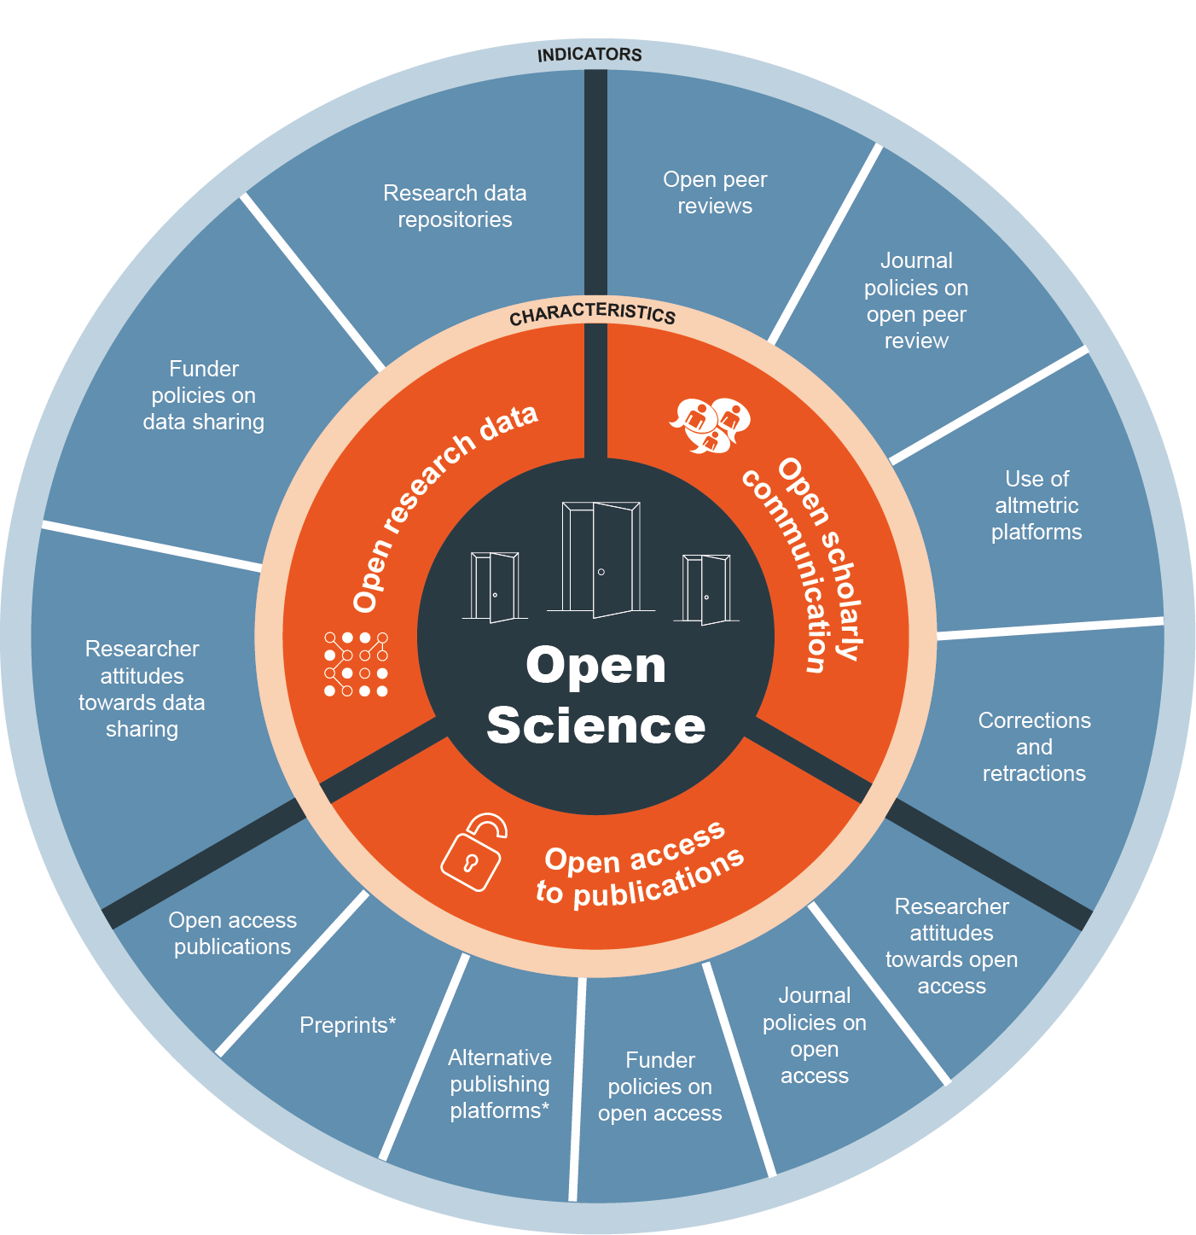
Source

Slide 3
Open Science: A Global Shift
Open Science is transforming research through transparency, accessibility & reusability.
Funders (e.g. European Commission, Horizon Europe) mandate open access to publications and underlying data, software & workflows as well as preparing and publishing Data Management Plans.
Research outputs must follow FAIR principles: Findable – Accessible – Interoperable – Reusable.
Repositories should be trusted and certified.
FAIR compliant data sharing

Slide 4
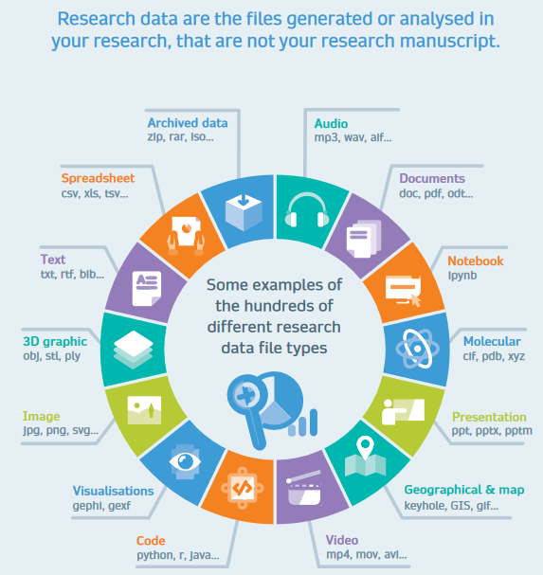
Research data
VIR: Springer nature

Slide 5
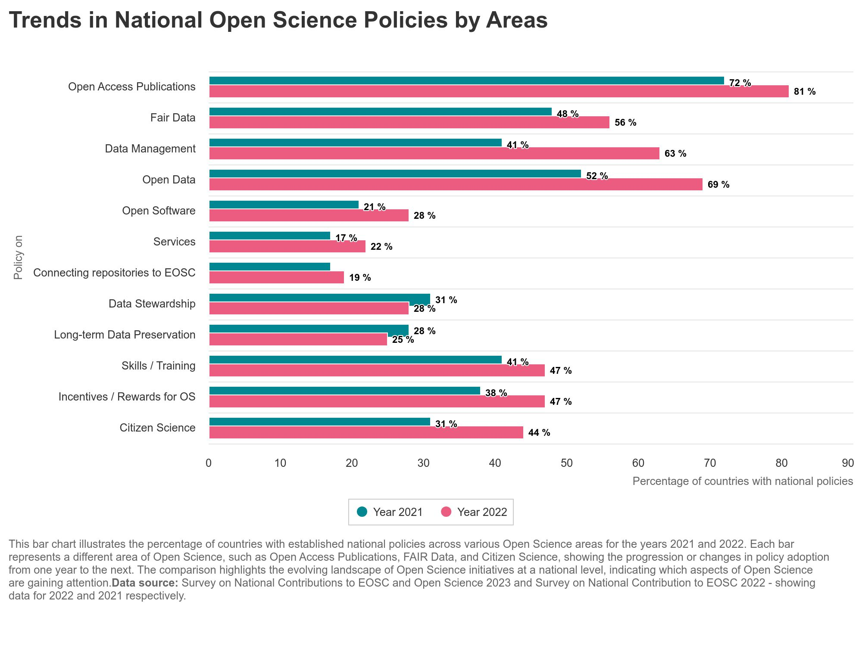

NATIONAL POLICIES

Slide 6
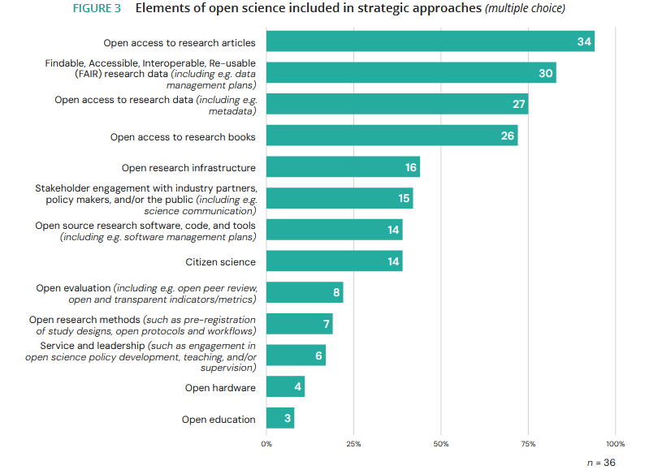


RFO + RPO = funders

Slide 7
Case of Slovenia: National legislation
Slovenian legislation containing open science provisions that research performing organizations, researchers and support services need to comply with:
- The Scientific Research and Innovation Activities Act (adopted in 2021) with open science provisions in Art. 40-42 (i.e., open access to research results, processing of personal data for research purposes, responsible research assessment, citizen science, open access national scientific journals and monographs).
2025 amendment of the act introduce Secondary Publication Right, i.e., deposit of the Author Accepted Manuscript into the repository and immediate open access via the repository.
- Public Information Access Act (adopted in 2003, lastly amended in 2023) with provisions in Art. 6. č on open access to publicly funded research data to enable their re-use.

Slide 8
Case of Slovenia: National legislation
Decree on the Implementation of Scientific Research Work in Accordance with the Principles of Open Science (adopted in 2023) with provisions on
requirements and implementation of open access to publications,
to FAIR research data and other research results in digital form,
on managing copyright in accordance with the principles of open science,
involvement of the interested public in scientific research,
eligible costs of scientific research work in accordance with the principles of open science,
change of research assessment,
and national ecosystem of open science.
Rules on Conditions for Providing Library Public Service (adopted in 2023) specifying in Art. 45(3) that academic libraries need to ensure open access to final works of studies and publications of employees of a higher education institution.

Slide 9
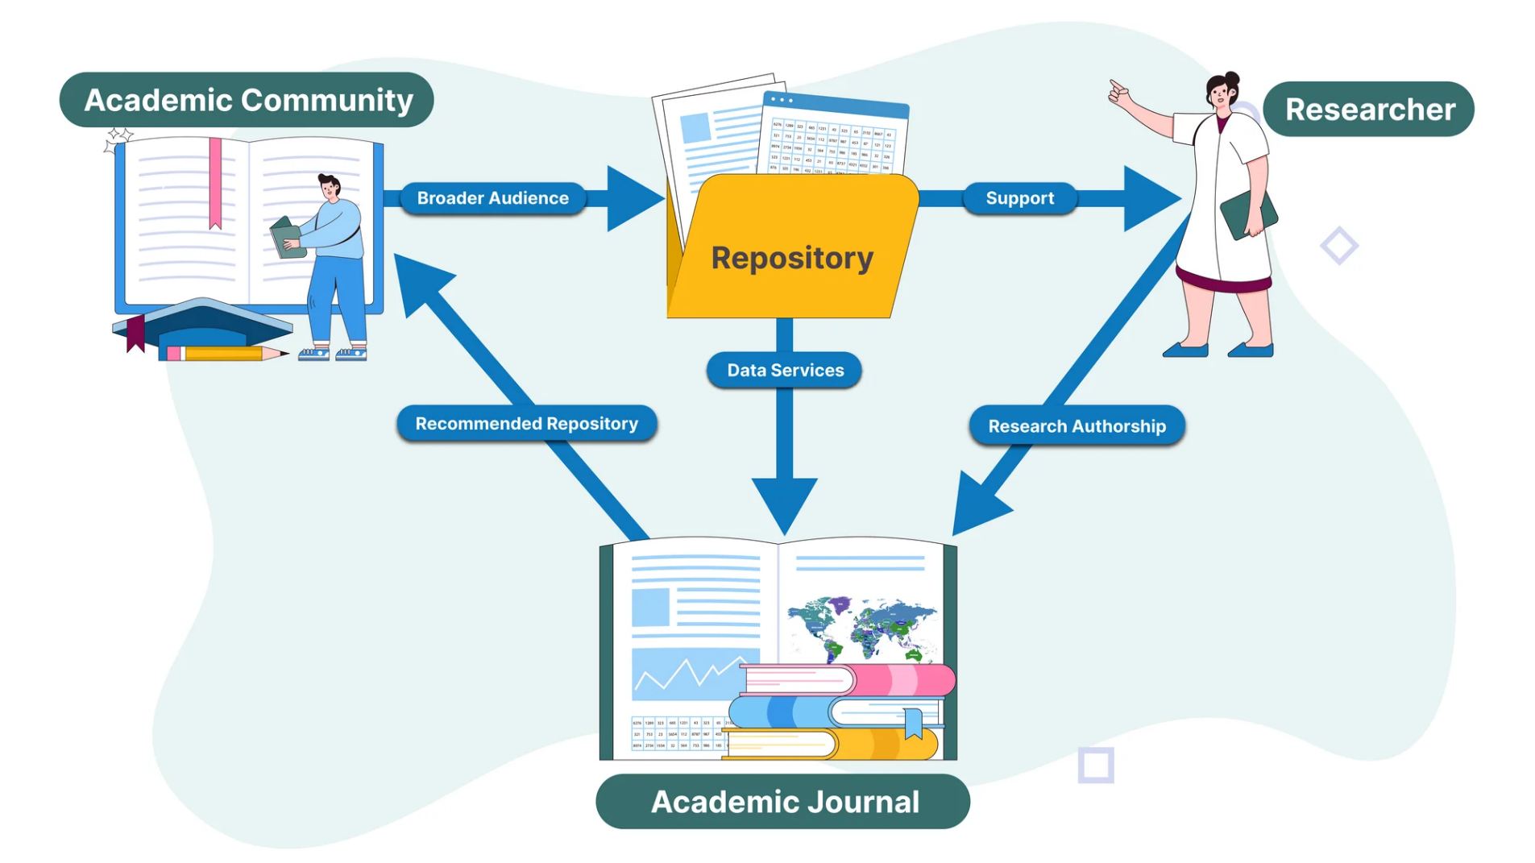
Challenges
Outdated practices persist despite awareness of Open Science.
Key issues:
Data published without proper legal/ethical basis (consent).
Insufficient documentation.
Poor or missing metadata → limits reuse.

Slide 10
Action Plan for Open Science
The Slovenian government adopted the Resolution on the Slovenian Scientific Research and Innovation Strategy 2030 (ReZrIS30), https://www.gov.si/assets/ministrstva/MIZS/Dokumenti/ZNANOST/Nacionalni-dokumenti/Resolution-on-the-Slovenian-Scientific-Research-and-Innovation-Strategy-2030.
Action plan for Open Science for the implementation of Objective 6.2: Open Science to improve the research quality, efficiency, and responsiveness of the Resolution on the Slovenian Scientific Research and Innovation Strategy 2030 (ReZrIS30): EUR 16,7 mio
Infrastructure projects: cca EUR 25 mio
New data warehouses (cca 60 PB) and new network for the transfer of big data.

Slide 11
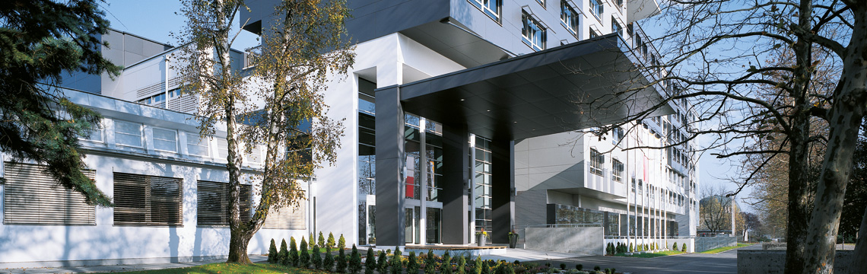

ADP - Arhiv družboslovnih podatkov Slovenian Social Science Data Archives
Training for:
Data depositors
Data users
PhD students
Research data management
🗓️ Established: 1997
📌 Role: National center for social sciences
🌐 Membership: CESSDA ERIC Consortium of European Social Science Data Archives
🔒 Trust: Core Trust Seal certificate (since 2018)
💾 Repository: Dataverse repository
🔗 Website: www.adp.fdv.uni-lj.si
780 surveys
90 + depositors
500 +registered users/year

Slide 12


Support for implementation of Open Science Principles in Slovenia Budget: 4M Co-financed by the Ministry of Higher Education, Science and Innovation and the European Union – NextGenerationEU through the National Recovery and Resilience Plan. All RPO and Central Technical Library (all 4 SI universities) | University of Ljubljana: 26 faculties and academies All scientific disciplines and the arts In 2024: Yearly income: 535.4 million € 7,138 staff, among them 4,656 teachers and researchers 37,472 students, among them 2,423 PhD students 626 active European projects 3,774 WoS publications 4 Data stewards + Coordinator

Slide 13
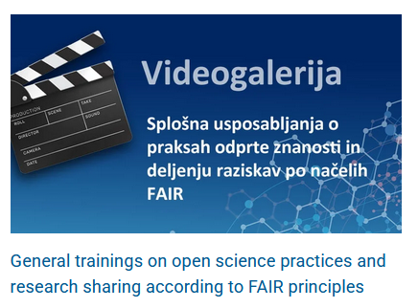
How?
With raising awareness, educating, and empowering the consortium partners' staff by providing them with relevant knowledge and skills in open science. This includes developing educational materials, establishing support structures, and adapting the operational processes of the consortium partners to align with the principles of open science.
With adoption of internal acts and adjustments in accordance with legal requirements (e.g., regulations, work instructions, etc.) to establish and adjust the technical and organizational structures at the level of consortium partners.
146 videos from webinars, training, OS event

Slide 14
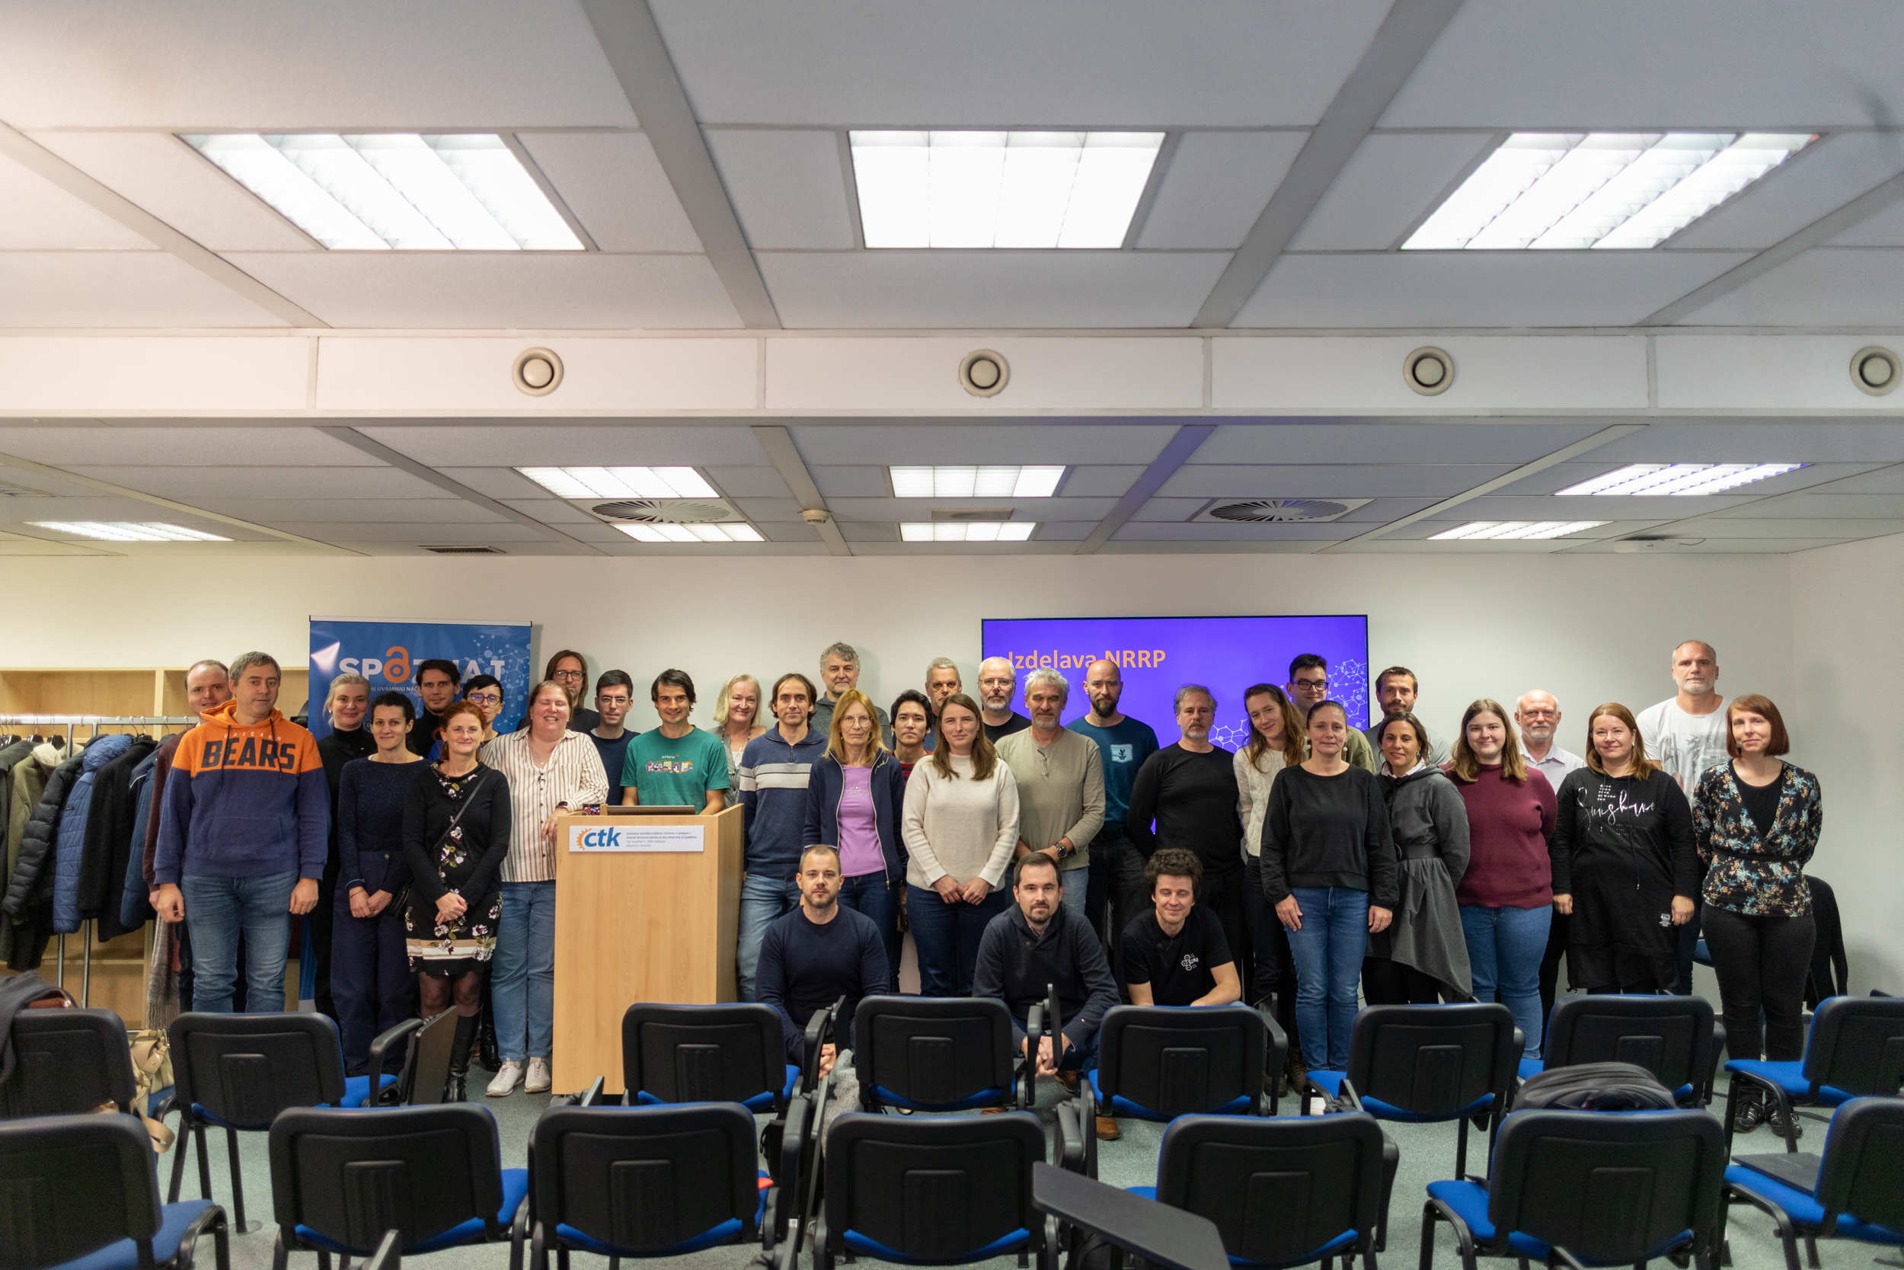
Data Steward Training Program
A 72-hour course with diverse content:
legal aspects of open science
the life cycle of research data
open science infrastructure
research data management plans
tools for working with data
practical workshops on RDM
There were more than 30 lecturers from Slovenia and abroad.
There were more than 30 participants in person, with over 100 joining online.
A mutual support group.
The next training course starts in October 2025.
https://projekt-spoznaj.si/en/2-training-for-data-professionals-autumn-winter-2025-26/

Slide 15
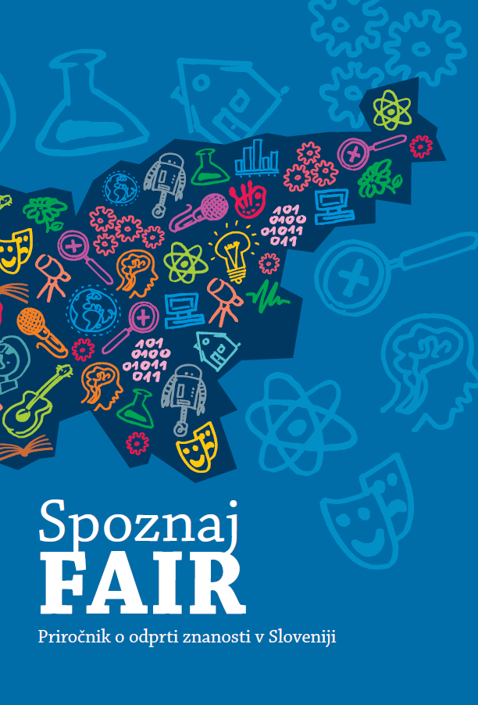
Handbook and manual
The development of the concept of open science and its fundamental principles
Provisions on open science in Slovenia
The life cycle of research in open science
Documenting research results
Compliance of research results with the FAIR principles
National open science infrastructure
Open licences
Research results in open science
Open peer review
Citizen science
DOI: 10.26493/978-961-293-328-9.

Slide 16
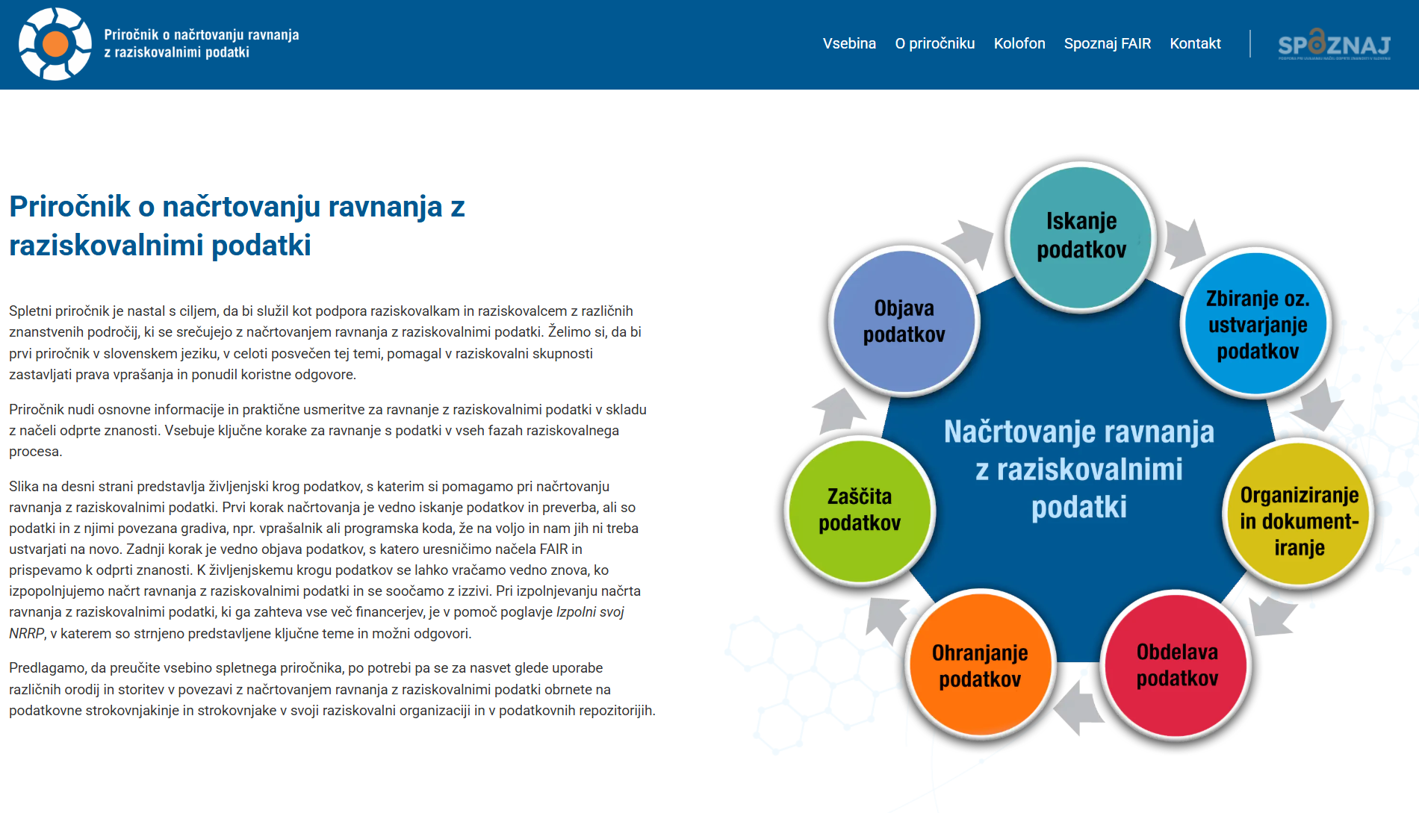
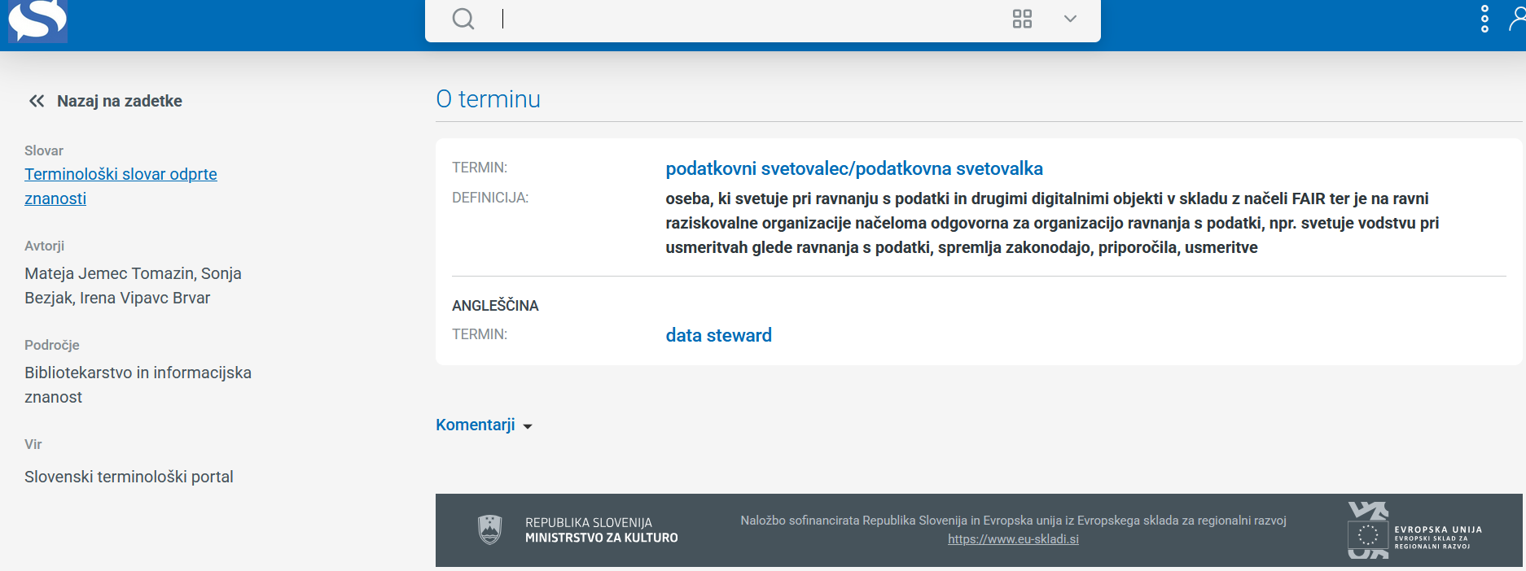
https://nrrp.odprtaznanost.si/
Open science terminology dictionary

Slide 17
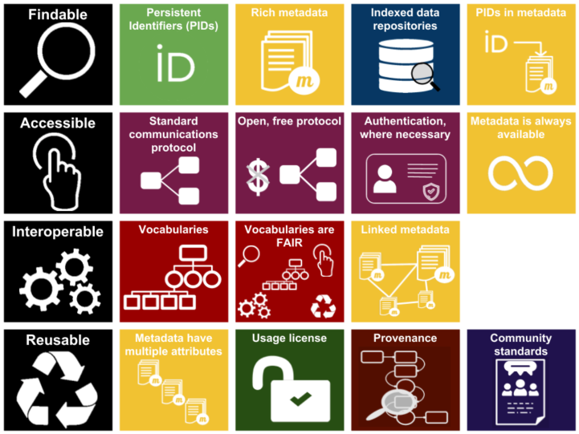
FAIR Data Principles
Image licensed CC‑BY‑SA /
Source: GO FAIR infographic via ANDS

Slide 18
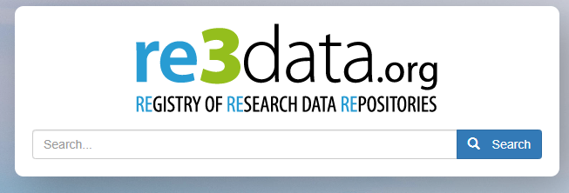
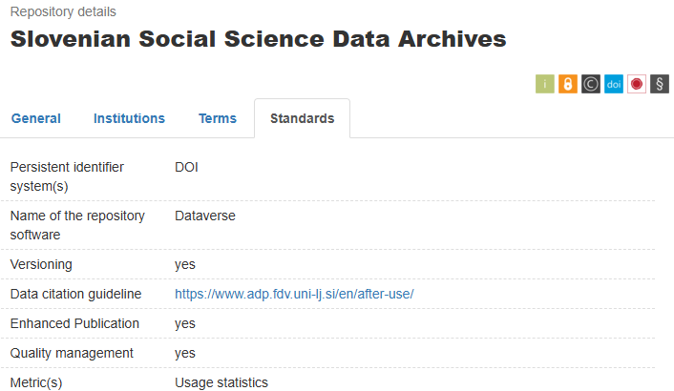
Persistent Identifiers
A persistent identifier (PID) uniquely and permanently identifies a digital object
Examples of PIDs (from re3data.org):
DOI, URN, ARK, HDL, PURL
! Without a PID:
No guarantee the URL will remain valid
Materials are likely to become inaccessible
Example: The ADP description in Re3Data.org states that ADP uses DOI.
Source: Bezjak, S., & Vipavc Brvar, I. (2025, August 29). Publishing and Finding Research Data – From Archiving to Reuse. Zenodo. https://doi.org/10.5281/zenodo.17147933

Slide 19
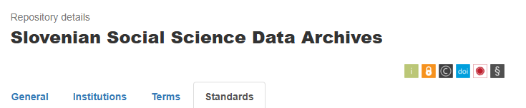

Metadata Standards
Repositories usually specify the metadata standard in theirguidelines
You can contact the repository for more information
DDI is Well Recognized in Social Sciences
📊 Designed for social science research data: captures survey, questionnaire, and observational data
🔗 Supports interoperability: widely adopted across institutions and repositories
📝 Standardized documentation: ensures clarity, consistency, and reusability of datasets
🌍 Facilitates data sharing and secondary analysis: helps researchers understand and reuse data reliably
ADP uses:
DDI metadata standard
Controlled vocabularies (link)
Source: Bezjak, S., & Vipavc Brvar, I. (2025, August 29). Publishing and Finding Research Data – From Archiving to Reuse. Zenodo. https://doi.org/10.5281/zenodo.17147933

Slide 20
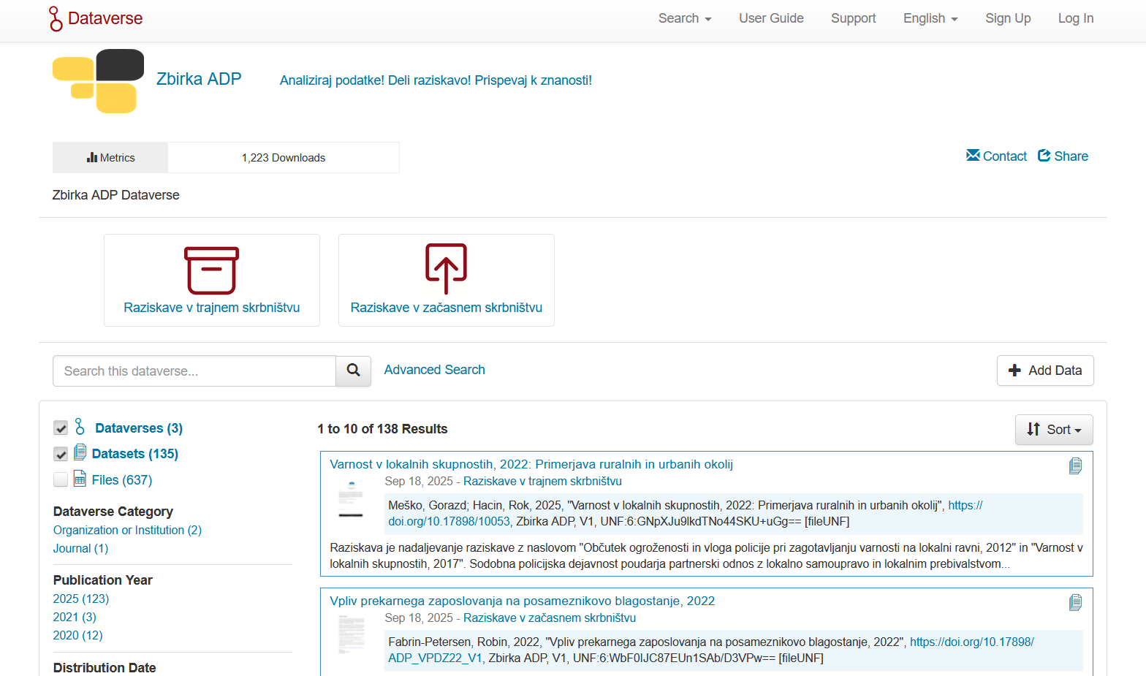
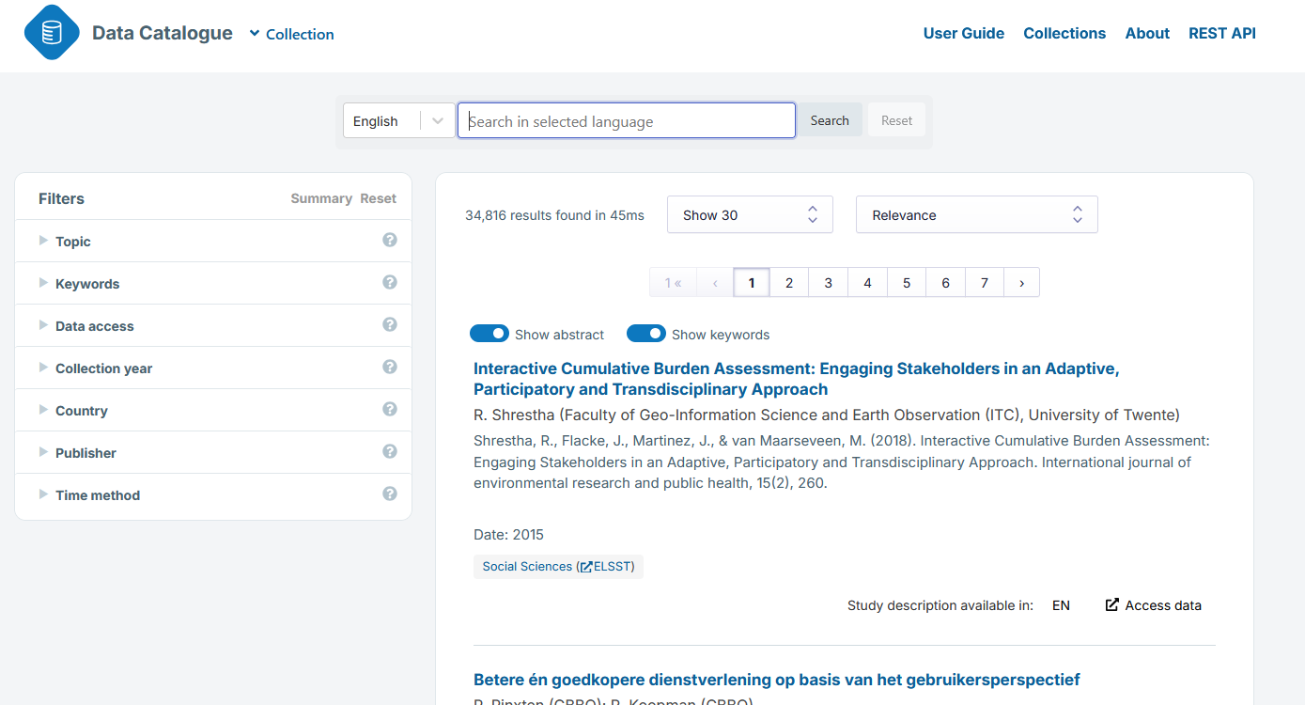
Indexed Data Repositories

Slide 21
Access Categories
Check what access restrictions the repository offers: → Access Options for Sensitive Data
Secure connection
Secure room
Limited user groups
ADP offers the following types of access:
🔓 Access without registration
📝 Access after registration
🔒 Access under special conditions:
Scientific Use File (SUF)
Secure Use File (SCUF)
https://www.adp.fdv.uni-lj.si/en/access-types/
Source: Bezjak, S., & Vipavc Brvar, I. (2025, August 29). Publishing and Finding Research Data – From Archiving to Reuse. Zenodo. https://doi.org/10.5281/zenodo.17147933

Slide 22


Controlled Vocabularies
📚 Controlled vocabulary (CV): a set of standardized terms for describing a specific field or topic
CESSDA Vocabulary Service: Provided by the Consortium of European Social Science Data Archives (CESSDA), version 3.4.0 (2025-03-18)
Features:
🔍 Discover, browse, and download CVs in multiple languages
💾 Available in SKOS, HTML, PDF formats
✏️ Editor for authorized users to create, manage, and translate vocabularies
📊 Standards: Many vocabularies created/maintained by the DDI Alliance (Data Documentation Initiative)
🌐 Purpose: Facilitates harmonisation of data descriptions (e.g., in CESSDA Data Catalogue)
Collaboration: Non-English versions provided by CESSDA members; organisations can contribute new languages or topic classifications
https://vocabularies.cessda.eu/
The European Language Social Science Thesaurus
Source: Bezjak, S., & Vipavc Brvar, I. (2025, August 29). Publishing and Finding Research Data – From Archiving to Reuse. Zenodo. https://doi.org/10.5281/zenodo.17147933

Slide 23
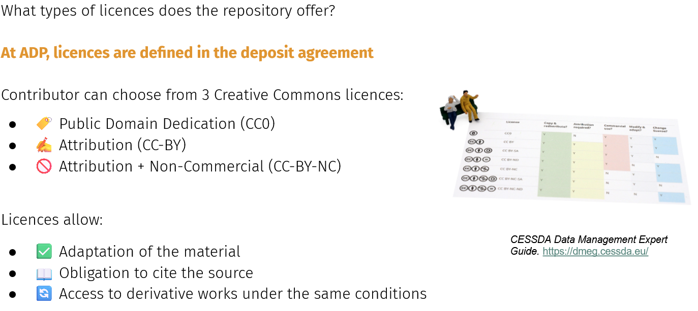
Repository Licences
Source: Bezjak, S., & Vipavc Brvar, I. (2025, August 29). Publishing and Finding Research Data – From Archiving to Reuse. Zenodo. https://doi.org/10.5281/zenodo.17147933

Slide 24
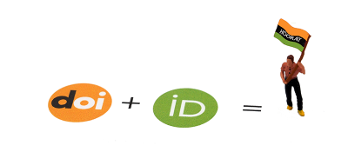

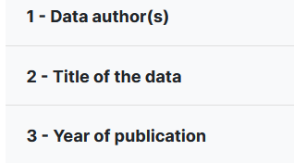
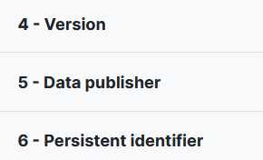
Data Citation
By publishing your data, the repository provides bibliographic information for citation
Pay attention to:
📝 Title of the data publication
👥 Authors of the data publication
Example of citing a data publication in ADP:
Badalič, V. (2021). Syrian refugees in Turkey, 2019: Syrian refugees in the informal labor market in Turkey [Data file]. Ljubljana: University of Ljubljana, Slovenian Social Science Data Archives. ADP - IDNo: SB19. https://doi.org/10.17898/ADP_SB19_V1
By publishing your data, the repository provides bibliographic information for citation
Pay attention to:
📝 Title of the data publication
👥 Authors of the data publication
Example: Badalič, V. (2021). Syrian refugees in Turkey, 2019: Syrian refugees in the informal labor market in Turkey [Data file]. Ljubljana: University of Ljubljana, Slovenian Social Science Data Archives. ADP - IDNo: SB19. https://doi.org/10.17898/ADP_SB19_V1
CESSDA Data Management Expert Guide. https://dmeg.cessda.eu/
https://datacitation.cessda.eu/The-Anatomy-of-a-Data-Citation
Source: Bezjak, S., & Vipavc Brvar, I. (2025, August 29). Publishing and Finding Research Data – From Archiving to Reuse. Zenodo. https://doi.org/10.5281/zenodo.17147933

Slide 25
Key takeaways
Repositories are key enablers of FAIR, trustworthy research.
DMPs + certified repositories = better data quality & reuse.
National initiatives (SPOZNAJ) bridge policy & practice.
International infrastructures (CESSDA) ensure cross-border standardisation.

Slide 26
Contact

