Slide 1

Applying FAIR data principles in social sciences
Part 2 – Metadata and study related documentation
Janez Štebe (ADP/UL/CESSDA)
23. November 2022/ Lecture at Rigas Stradina University Doctoral school

Slide 2
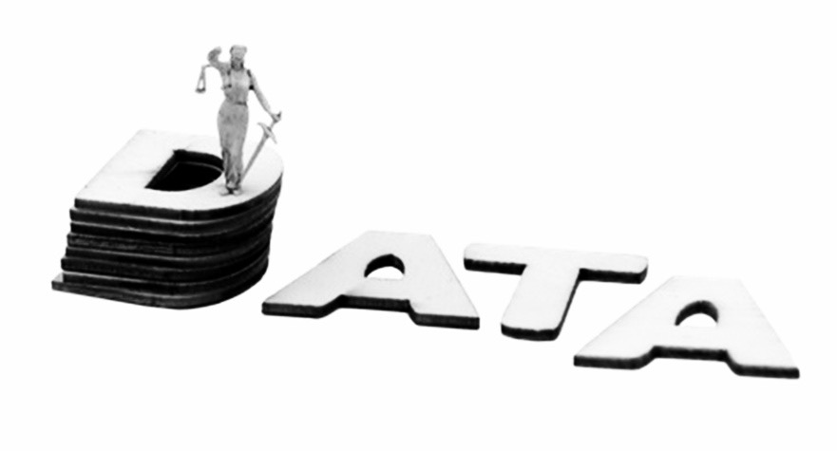
DMP Data Management Plan
Formal document that provides a framework for how to handle the data material during and after the research project.
But!
DMP is not only a FORMAL document required by the funder!
Researchers must understand that DMP is an extremely practical tool:
DMP substantially improves the workflow in the project
Notes:
Key focus on data management planning during the entire data lifecycle. Reinforcing that the DMP is more than an additional document researchers must prepare, and more the skeleton of their research project.

Slide 3
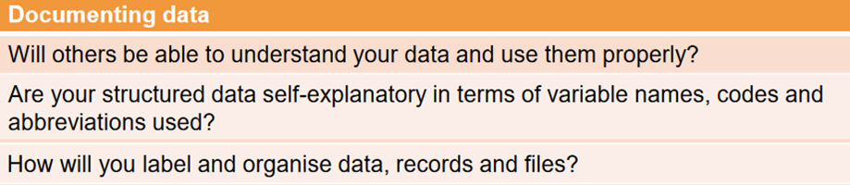
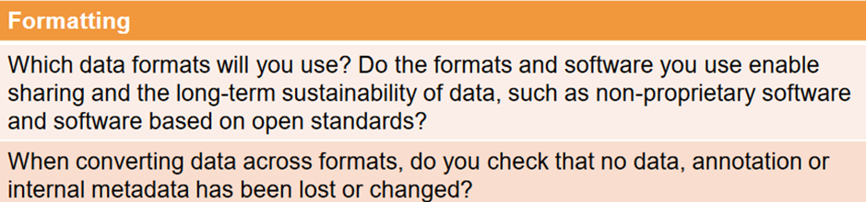
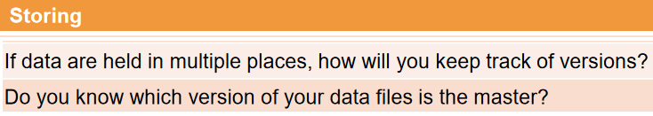
Recap Lecture one - DMP questions addressed
Inspired by: DMP Checklist
Useful to remind you on critical aspects of your data management project
Source: Hina Zahid, Cristina Magder, Anca Vlad, & Maureen Haaker. (2022, February 23). Data Management Planning and Overcoming Challenges in Social Sciences Data Sharing - Day 1. Zenodo. https://doi.org/10.5281/zenodo.6246973

Slide 4
Lecture 2 outline
Consent
Access regimes and licences
Metadata, Controlled vocabularies and related materials
Publishing data in appropriate repository

Slide 5
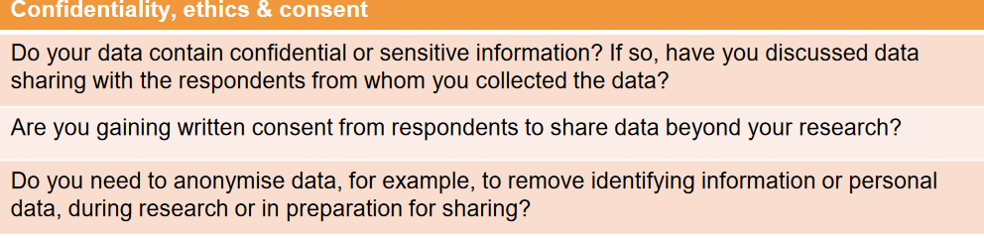

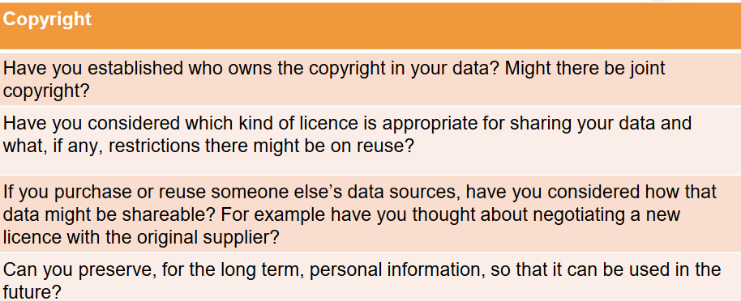
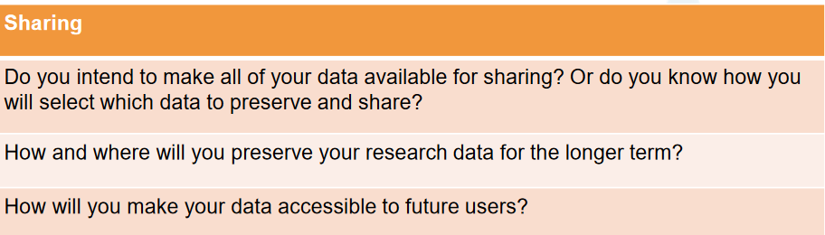
Lecture two - DMP questions addressed
Notes:
Sharing data ‘on-demand’ proves to be inefficient. The owner of the data often does not respond, or even he is not accessible anymore…

Slide 6
Consent to participate in a study
Types of Consent
  GDPR consent: explicit, documented, granular… can be used as basis for processing personal data
  Ethical consent: informing participants about study purpose, benefits and risks, voluntary participation … does not need to be detailed…
Consent in Social Media research
Consent language to use
Notes:
Balancing the purpuse (benefit) of a study and participants burden…

Slide 7
Dealing with the issue of consent is inherent to social scientific studies
When dealing with human beings, questions of ethics play a central role
When it comes to data archiving further complications come into play
  F.A.I.R. data should be stored, made available and useable for scientific purposes, but: unrestricted access to data could hurt individuals
  As open as possible and as secure as necessary
Notes:
When it comes to teaching on ethical considerations drawing the attention that behind social sciences data there are actual human participants is of key importance. Explaining how both researchers and archivists are always balancing sharing FAIR and Open data with ethical considerations.

Slide 8
What is expected from the information letter and consent forms and how does this tie to ethics?
An explanation of the purpose of research and the expected role of the research subject
A description of the type of data collected (especially sensitive data)
A description of any foreseeable risks and what will be done to minimize them
A description of how the data is processed, including who may have access to research data (relevant for archiving) !!!
A statement that participation is voluntary
The role of archive is to promote legal and ethical sound practices in data sharing.
Notes:
Providing clear examples of what a consent form should include and again highlighting the roles of data stewards in helping researchers conduct both ethical and legal research.

Slide 9
Informed consent in Social Media data
Do I need to obtain informed consent from the social media users?
  If information is collected directly from individuals the research will be understood as involving humans and so often requires informed consent.
How will the data be accessed?
  Researchers are advised to check conditions of copyright and the Terms of Service (ToS).
What do I have to think about when linking survey results to social media data?
  Informed consent should be obtained if survey data are to be linked to social media data.
Appendix A: Short guide on legal and ethical issues for the researcher to consider when using social media for research. In: Report on legal and ethical framework and strategies related to access, use, re-use, dissemination and preservation of social media data. https://seriss.eu/wp-content/uploads/2019/11/D6.3-Report-on-legal-and-ethical-framework-and-strategies...__FINAL.pdf

Slide 10
Decision making framework for publishing Tw. Data
Distinguish
  Public (no consent)
  Opt-out
  Opt-in
Williams, Matthew L, Pete Burnap, and Luke Sloan. ‘Towards an Ethical Framework for Publishing Twitter Data in Social Research: Taking into Account Users’ Views, Online Context and Algorithmic Estimation’. Sociology 51, no. 6 (December 2017): 1149–68. https://doi.org/10.1177/0038038517708140.

Slide 11
Recommended Informed Consent Language for Data Sharing
Future use and reuse of the information by others.
Specify in which form the data will be deposited, e.g. de-identified, pseudonymised transcripts, audio recording, survey database, etc.; and if needed repeat the statement for each form of data you plan to deposit. Specify whether deposited data will be de-identified, and how. Specify whether use or access restrictions will apply to the data in future, e.g. exclude commercial use, apply safeguarded access, etc.; and discuss these restrictions with the repository in advance.
Some concerns
  Term "anonymous" is left open to interpretation
  Avoid: „Only the research team will have access to information“
  Do not mention an expiration time period or promise that all data will be destroyed.
Better:
  „Any personal information that could identify you will be removed or changed before files are shared with other researchers“
  It avoid vague meaning of ‚anonymous‘.
  It does not promise all indirect identifiers will be removed: preserves the possibility of sharing data under restricted regime
See more on https://www.icpsr.umich.edu/web/pages/datamanagement/confidentiality/conf-language.html
https://ukdataservice.ac.uk/learning-hub/research-data-management/ethical-issues/consent-for-data-sharing/

Slide 12
Questions for consent section?
Exercise:
We will anonymize all data before sharing it in a trusted digital repository. No one will be able to identify you from that data.
https://managing-qualitative-data.org/exercises/5/

Slide 13
Access regimes and licences
Standard access regimes
Licences

Slide 14
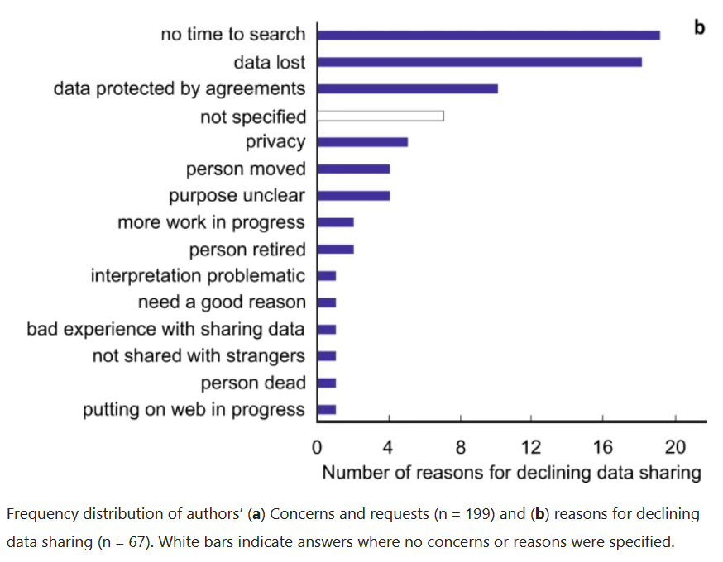
Data Availability upon Request regime
Sloppy fulfilment of mandatory data sharing : “broken links, the lack of metadata or the authors’ lack of willingness to share upon request”
Some suggested remedy actions:
Allow for embargo
Provide citable data publication (possibility of enlisting in grant and job applications alongside with other bibliometric indicators)
Surveillance of data sharing should be enforced by both academic publishers and funders
Tedersoo, Leho, Rainer Küngas, Ester Oras, Kajar Köster, Helen Eenmaa, Äli Leijen, Margus Pedaste, et al. ‘Data Sharing Practices and Data Availability upon Request Differ across Scientific Disciplines’. Scientific Data 8, no. 1 (December 2021): 192. https://doi.org/10.1038/s41597-021-00981-0.

Slide 15
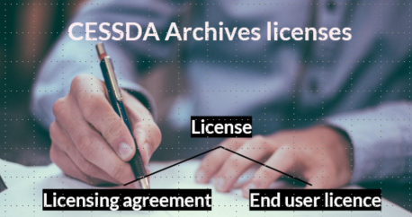
While sharing data, data owner need to assign the access conditions and licence to the data
                Users need to understand and adhere to the Terms of use (licences and restrictions)

Slide 16
Access regulations categories at Slovenian ADP
Open Access
Users may freely access the catalogue of the ADP, study metadata and research data. Nonetheless, the use of data and accompanying materials is limited by the legislation, and the social sciences ethical standards.
Standard Access
Users need to fill in the Registration form to access materials in the Catalogue of the ADP and comply with the General Provisions of and Terms of Use of the ADP. Research data that may be accessed by a standard registered user, are fully anonymized. These are the so-called Public Use Files (PUF).
Special Conditions Access
If a user wants access to files in the Special Conditions Access section, not only a regular registration form (Standard Access) should be filled in but also an additional one which is called: "Application for access to materials on request". The Commission for the protection of Confidentiality carefully inspects such applications and decides on the possibility of access to the requested study data.
  Data are not fully anonymized
  Such files are called Scientific Use Files (SUF).
  Embargo
  The authors place an embargo on access and decide that the datasets will only be available after a certain period of time, for example, after 6 months.
Access in a safe environment
If the data are especially sensitive the user may be granted access to it only in a safe room of the data archive. These are the so-called Secure Use Files (ScUF) that the user may access only after signing a special contract, determining the rights and obligations of use of the requested research data.

Slide 17
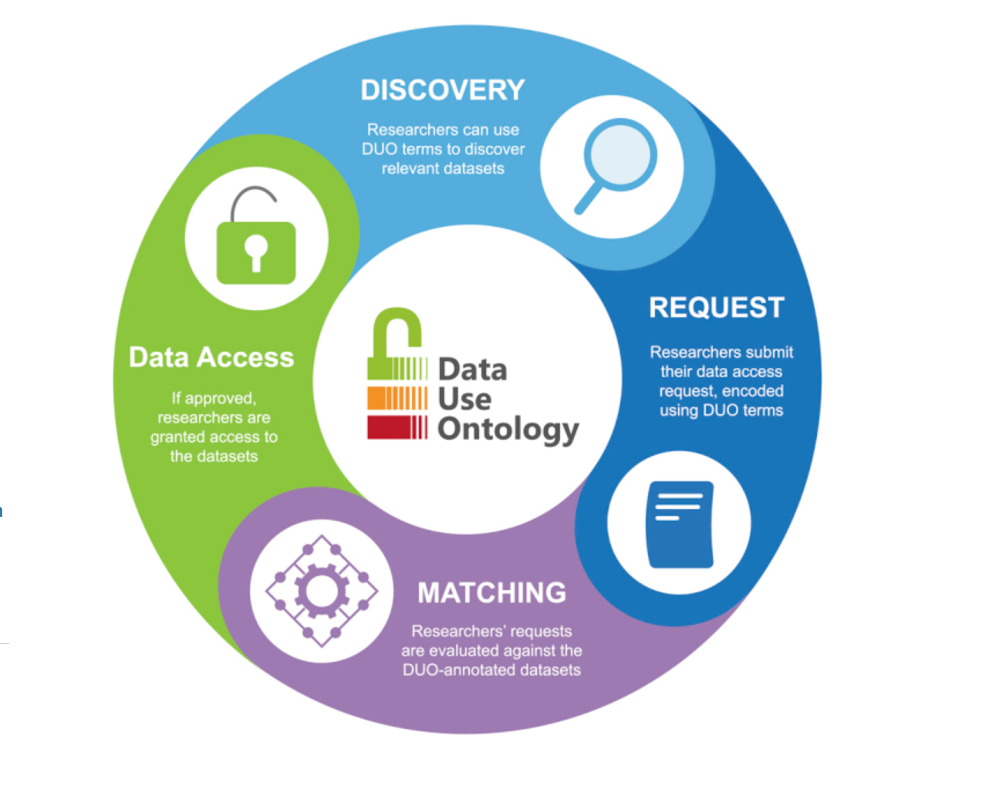
Advanced examples: Standard (restricted) access categories
Most CESSDA Archives provides options for restricted access; they do not use exactly the same terms and conditions
There is no ontology accepted yet; different initiatives to harmonise:
E.g. biomedical data sharing, The Data Use Ontology :
  Using DUO in data management and access facilitates researchers' discovery and access of relevant datasets. DUO annotations increase the FAIR-ness of datasets and support data linkages using common data use profiles when integrating the data for secondary analyses.
Lawson, Jonathan,, et al. ‘The Data Use Ontology to Streamline Responsible Access to Human Biomedical Datasets’. Cell Genomics 1, no. 2 (November 2021): None. https://doi.org/10.1016/j.xgen.2021.100028.

Slide 18
Initiative for standard access categories in sharing official microdata
Eurostat + selected National Banks in EU
This working group laid the foundation for assessing a potential harmonisation of access procedures in INEXDA member institutions. Furthermore, the INEXDA annodata schema is a notable step towards the automation of workflows providing access to micro data.
Detailed description of the INEXDA annodata schema (1) Access regime (Occ. 1-n)6
1.1 Identification of access regime (Occ. 1)
1.1.1 Access regime ID (Occ. 1)
1.2 Access mode (Occ. 1-n)
An access mode describes an access protocol by which a specific type of researcher conducting a project in a specific type of research field is granted access to a specific type of dataset family.
1.2.1 Type of access mode (Occ. 1)
Mode of access that is available under the conditions stated above.
    ▪ Secure on-site access: Provision in the premises of the institution in a dedicated secure environment.
    ▪ On-site access: Provision via the institution’s IT infrastructure.
    ▪ Remote execution: Researcher sends code and RDC sends back results.
    ▪ On-site in partner institution: On-site access in partner institution.
    ▪ Remote on-site access: Remote access for internal researchers (e.g. teleworking).
    ▪ Remote access: Researcher can access data remotely from own institution.
    ▪ Download: Scientific use files or public use files.
1.2.2 Degree of anonymisation (Occ. 1)
1.2.3 Researcher type (…)
FINAL REPORT OF THE INEXDA WORKING GROUP ON DATA ACCESS
May 2020 https://www.inexda.org/wp-content/uploads/2020/05/FINAL_INEXDA_WG_DA_Final_Report.pdf

Slide 19
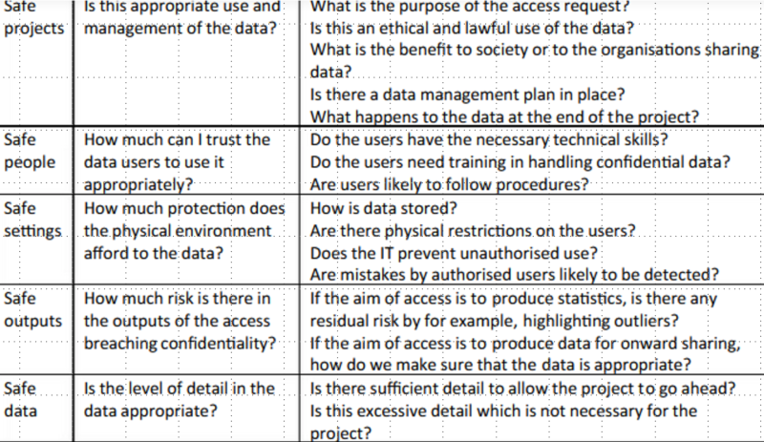
5 safe framework
https://en.wikipedia.org/wiki/Five_safes
https://ukdataservice.ac.uk/help/secure-lab/what-is-the-five-safes-framework/
Base for decisions about making effective use of data which is confidential or sensitive.

Slide 20
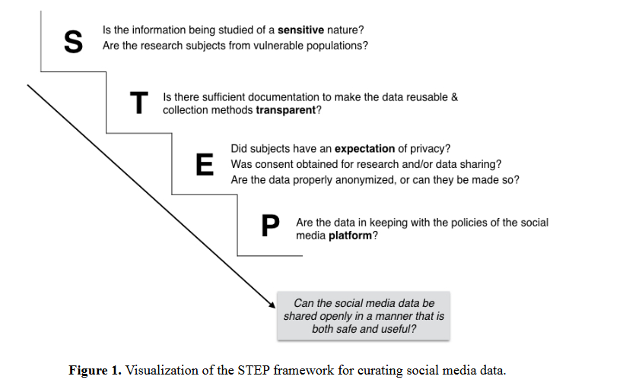
Considerations about degree of openness
Mannheimer, Sara, and Elizabeth A. Hull. ‘Sharing Selves: Developing an Ethical Framework for Curating Social Media Data’. International Journal of Digital Curation 12, no. 2 (18 April 2018): 196–209. https://doi.org/10.2218/ijdc.v12i2.518.

Slide 21
Legal challenges in sharing SM data
Assess the legal basis of the collected social media data and the rights
One may need to remove parts of the data (e.g., if they include copyrighted materials) and/or restrict access to the data
Contracts with platforms - Terms of Service
In the cases in which social media data have been archived, researchers and archives have generally aimed for complying with ToS as much as possible.
Breuer, Johannes, Borschewski, Kerrin, Bishop, Libby, Vávra, Martin, Štebe, Janez, Strapcova, Katarina, & Hegedűs, Péter. (2021). Archiving Social Media Data: A guide for archivists and researchers (1.2). Zenodo. https://doi.org/10.5281/zenodo.5041072

Slide 22
Example of „restricted“ sharing of SM data
data set “Geotagged Twitter posts from the United States: A tweet collection to investigate representativeness” contains “IDs of geotagged Twitter posts from within the United States” collected in 2014 and 2015.
The data are organized into many different files (including, e.g., tweet IDs and hashtags per day for U.S. states and counties) and are only available upon request.
In addition to these data files, there is also a Python script for retrieving the tweets using the list of tweet IDs; a process called rehydration.
As these data are larger, more sensitive, and more complex than the other social media data, the archiving was more complicated in this case.
More on challenges of SM data sharing:
Kinder-Kurlanda, K., Weller, K., Zenk-Möltgen, W., Pfeffer, J., & Morstatter, F. (2017). Archiving information from geotagged tweets to promote reproducibility and comparability in social media research. Big Data & Society, 4(2), 1–14. https://doi.org/10.1177/2053951717736336
Data citation:
Pfeffer, Jürgen, & Morstatter, Fred (2016). Geotagged Twitter posts from the United States: A tweet collection to investigate representativeness. . Data File Version 1.0.0, https://doi.org/10.7802/1166.
Python Script to rehydrate Tweets from Tweet IDs, https://doi.org/10.7802/1504

Slide 23
(Standard) Creative Commons licences
Exercise questions:
Are CC licences usable for licencing data?
Which one to use for which type of data access? (e.g. considering Open, PUF, SUF, ScUf types)
Licence | Can I copy & redistribute the work? | Is it required to attribute the author? | Can I use the work commercially? | Am I allowed to adapt the work? | Can I change the licence when redistributing?
CC0 | Y | N | Y | Y | Y
CC BY | Y | Y | Y | Y | Y
CC BY-SA | Y | Y | Y | Y | N
CC BY-ND | Y | Y | Y | N | Y
CC BY-NC | Y | Y | N | Y | Y
CC BY-NC-SA | Y | Y | N | Y | N
CC BY-NC-ND | Y | Y | N | N | Y

Slide 24
Example LICENCE.txt that accompany the replication data shared
„I certify that the author(s) of the manuscript have documented permission to redistribute/publish the data contained within this replication package.“
Appropriate permission are documented in the LICENSE.txt file. (Optional, but recommended)
License for Data INSTRUCTIONS:
  Most data repositories provide for a default license, but do not impose a specific license. Authors should actively select a license. This should be provided in a LICENSE.txt file, separately from the README, possibly combined with the license for any code.
  The LICENSE.txt file might contain the concatenation of all the licenses that apply (for instance, a custom license for one file, plus a CC-BY license for another file).
NOTE: A license may be sticky and be defined by the original data creator. Example: The data are licensed under a Creative Commons/CC-BY-NC license. See LICENSE.txt for details.
Summary of Availability
  All data are publicly available.
  Some data cannot be made publicly available.
  No data can be made publicly available.
https://social-science-data-editors.github.io/template_README/templates/README.pdf

Slide 25
Metadata, Controlled vocabularies and Related Materials
DDI 2.5 metadata
CESSDA and DDI controlled vocabularies: which information to keep during the project to be able to fill the information needed (data collection situation, measures to control quality, sampling characteristics and response rate)
ELSST
Related materials (reports, readme, LICENCE.txt...)

Slide 26
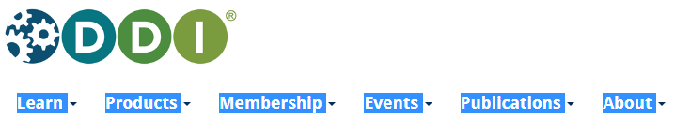
What is metadata?
Metadata is extremely important for FAIR (FAIR data and metadata)!
Metadata is structured machine and human readable information that
  Describes the context (study description) of data creation
  Where and how to find it, access and what are the conditions
  It can contain the description of the data files and variables
  Data documentation Initiative (DDI) is THE community accepted metadata standard used for social sciences, designed and kept by DDI alliance → https://ddialliance.org/

Slide 27
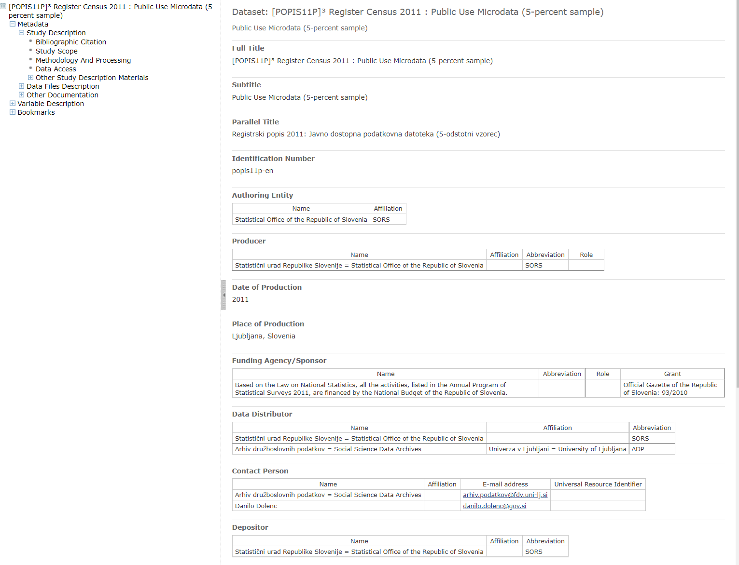
Metadata elements for citation

Slide 28
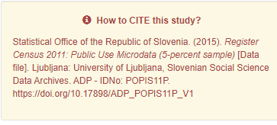
Citation of the published data
Elements of FAIR-ification:
Author(s) PID
Author(s) PID (eg. ORCID, or other global unique, persistent and resolvable identifiers)?
Organisation PID
Is there a specific field in the metadata schema of your repository dedicated to the Organisation PID of the Author(s)
Users (including data creator) are obliged to fully cite the data in the Bibliography of resulting research report
The Citation should include the Author, year, Publisher (or Data distributor), and the PID with the version number
„A persistent identifier (PI or PID) is a long-lasting reference to a document, file, web page, or other digital object. Most PIDs have a unique identifier which is linked to the current address of the metadata
https://www.adp.fdv.uni-lj.si/opisi/popis11p/

Slide 29
Funding information
In case the uploaded item is linked to a Research Grant:
  Funding Stream
Does the metadata schema of your repository contain a specific field to indicate the Funding Stream (e.g. H2020, Horizon Europe)?
o Project Name
(…)
o Project Acronym
.
o Grant Number
o Grant PID
Does the metadata schema of your repository contain a specific field for the Grant PID (which is different from Grant number, it is a PID, such as a DOI, or any other global unique, persistent and resolvable identifier associated with the grant)?

Slide 30
DDI Controlled Vocabularies
The benefits of CVs are easy to appreciate: using the same words to mean the same thing guarantees shared understanding
They also form the basis of machine-automation
The FAIR principles emphasize CVs –especially for Interoperability (I2)
Different purposes
  Search and navigate for collections of data (topics, keywords)
  Describe methodology
  File and data content (units, categories, variables „concepts“)
https://codata.org/initiatives/data-skills/ddi-training-webinars/ddi-controlled-vocabularies-the-cessda-workbench-skos-and-xkos/

Slide 31
The European Language Social Science Thesaurus (ELSST)
Multilingual thesaurus for the social sciences
The thesaurus consists of over 3,300 concepts and covers the core social science disciplines: politics, sociology, economics, education, law, crime, demography, health, employment, information and communication technology, and environmental science.
ELSST is used for data discovery within CESSDA and facilitates access to data resources across Europe, independent of domain, resource, language or vocabulary.
ELSST is currently available in 16 languages: Danish, Dutch, Czech, English, Finnish, French, German, Greek, Hungarian, Icelandic, Lithuanian, Norwegian, Romanian, Slovenian, Spanish, and Swedish.
Members of CESSDA collaborate on updates and translations
Since ELSST version 3 (Sept 2022), URNs are now available for all concepts e.g. dct:identifier urn:ddi:int.cessda.elsst:a712b1ab-d6da-4fd6-ad34-4eaebdb58f6f:3
CESSDA Metadata Office provides instructions about how to use it:
elements of study and data variables level metadata where it‘s appropriate to refere to ELSST terms
https://elsst.cessda.eu/index.html

Slide 32
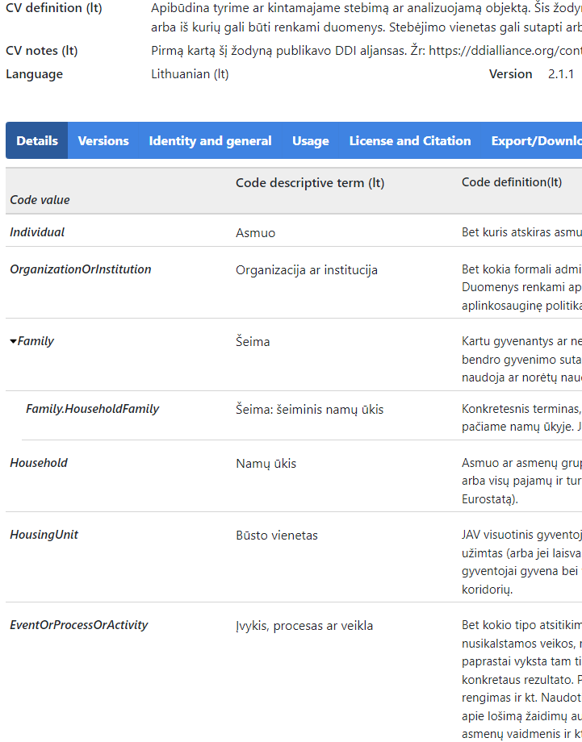
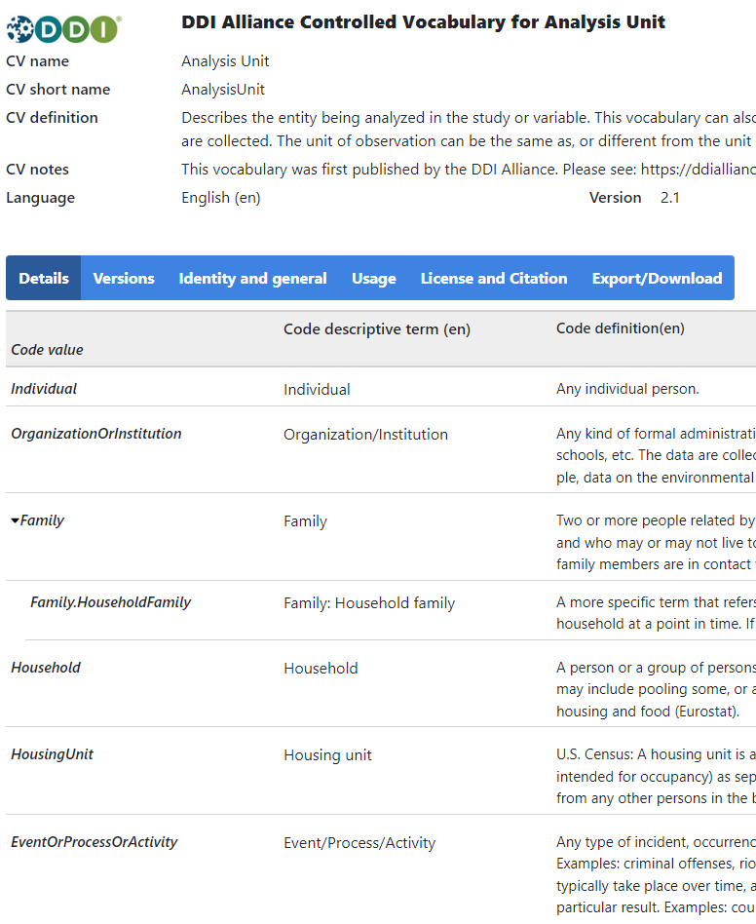
DDI CV examples
DDI 2.5 Usage
Element/Attribute name: anlyUnit@unit
Element/Attribute name: anlysUnit

Slide 33
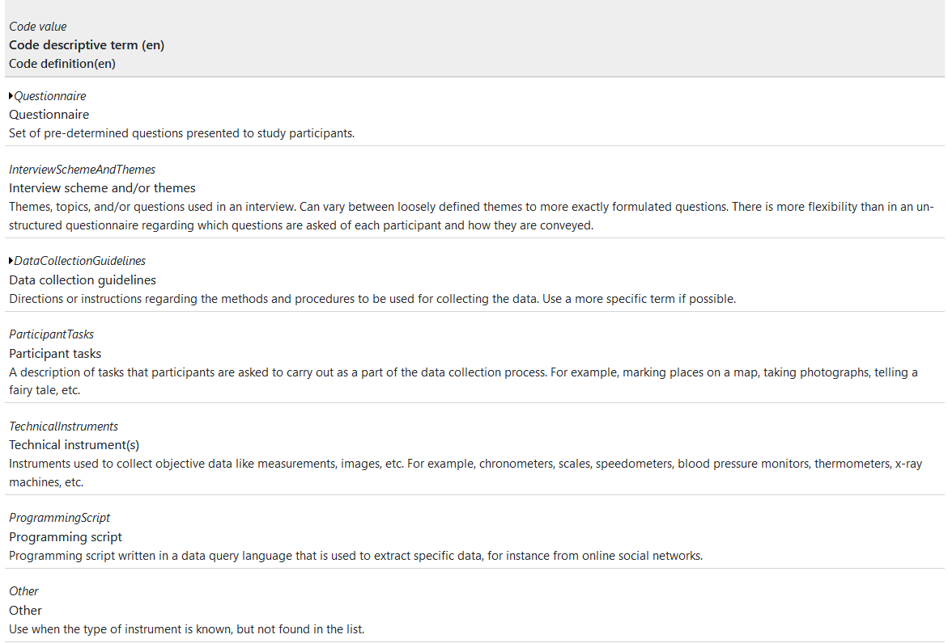
DDI Study Description Method section
Some usefull DDI/CESSDA CV for method section
Sampling Procedure (SamplingProcedure)
  A typology of sampling methods.
Type of Instrument (TypeOfInstrument)
  Includes a typology of data collection instruments.
Mode Of Collection (ModeOfCollection)
  The procedure, technique, or mode of inquiry used to attain the data.

Slide 34
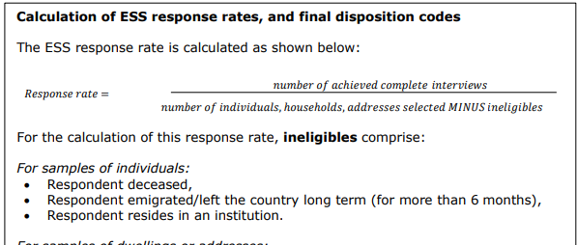
Some information for DDI metadata is descriptive
Example (Hafner-Fink et al. 2022):
Characteristics of Data Collection Situation
In this SJM survey it was possible to participate either online (self-completion of an online questionnaire) or over mail (self-completion of a letter questionnaire). A written invitation to participate was sent to all individuals from the sample list on November 9 with a personalized code to enter the online survey. The survey interface was created using the tool EnKlik survey - 1KA (open source application for web survey). In case the person didn’t want or couldn’t participate online they were given the option to respond via the letter questionnaire.
Actions to Minimize Losses
In the invite letter, we have promised a gift card worth 10 € to all the participants who will carefully and completely fill in the questionnaire (either online or in writing). After two, four and eight weeks a reminder to participate in the survey was also sent.
Weighting
With the raking method, a post-stratification weight was formed on a combination of variables: Gender x Age and Region x Type of Settlement.
Cleaning Operations
Data was cleaned. Logical controls and skips were performed. Logical controls and skips were performed.
Response Rate
There were 2,500 units in the sample, of which 1,022 duly completed the questionnaire. 147 individuals didn't wish to participate, 1331 units were unknown or inappropriate units. The participation rate is therefore 40.8 %.
DMP: Plan to collect information during data collection about details to be able to report afterward. Keep research logs for qualidata.
https://www.europeansocialsurvey.org/docs/round11/questionnaire/ESS11_project_specification.pdf
Hafner Fink, et al.. (2022). Slovenian Public Opinion, 2021/1: Mirror of Public Opinion, Health and Health Care (ISSP 2021), Attitudes towards work of the public prosecutor's, Attitudes towards Sport, Attitudes towards music [Data file]. Ljubljana: University of Ljubljana, Slovenian Social Science Data Archives. ADP - IDNo: SJM211. https://doi.org/10.17898/ADP_SJM211_V1

Slide 35
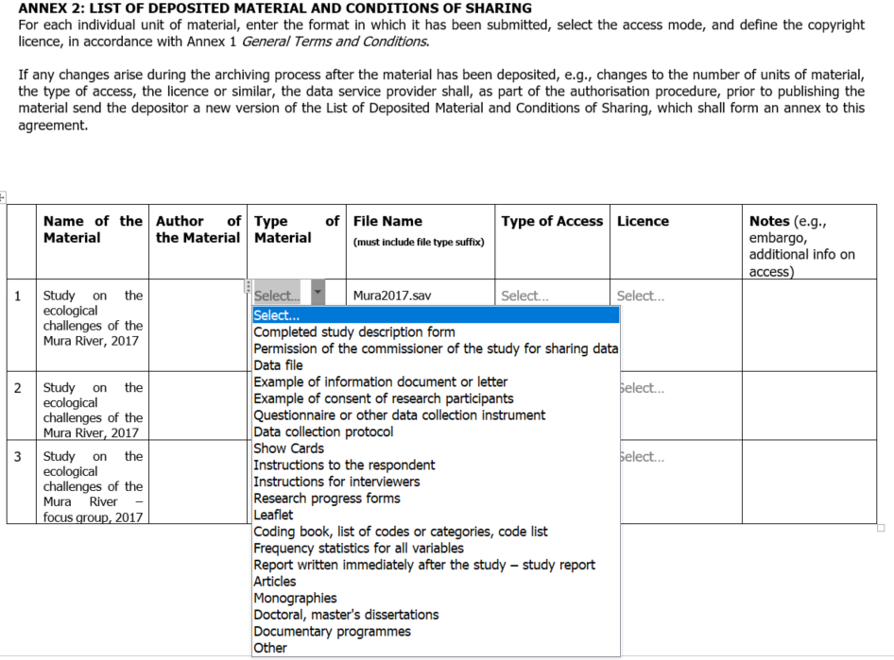
Related materials and documents to share
All related materials can be shared within the DDI metadata, including the actual access to the documents.
What is missing, that we already mentioned?
Reproductibility?

Slide 36
Publishing data in selected repository
CESSDA DCatalogue
Disciplinary vs. General repository
Long term preservation processing vs. Short term self-archiving
…

Slide 37
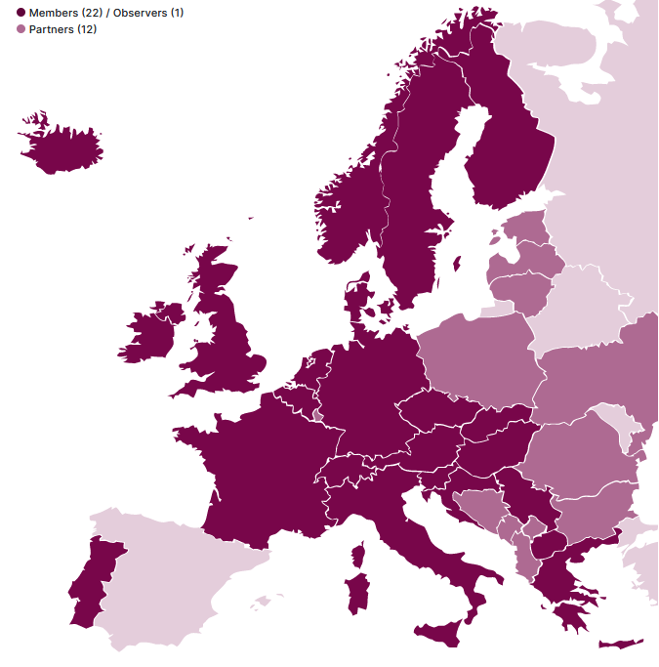
Our vision is that the provision of access to social science data and metadata is vital – for both science and society.
For this we must offer services to data producers to easily describe and store their data – if needed in a secured environment.
We will adhere to the FAIR (Findable, Accessible, Interoperable, Reusable) data principles to make data findable and provide information about the data, where they are, how they can be accessed.
We will also focus on providing training and enabling the transfer of expertise and sharing of knowledge on data, as well as relevant rules and regulations.

Slide 38
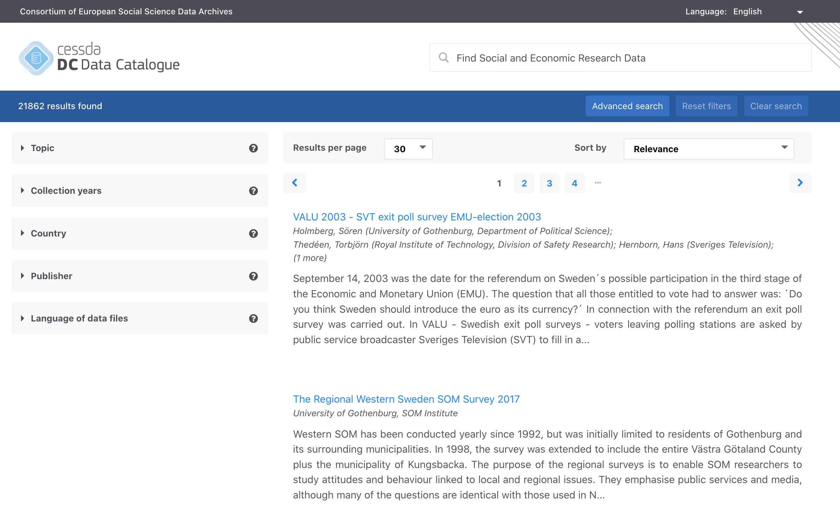
https://datacatalogue.cessda.eu/
CESSDA Data Catalogue

Slide 39
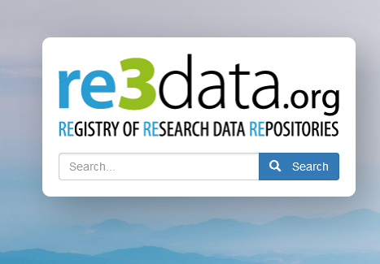
Advantages of CESSDA Services
Data, metadata and documentation review
Long-term preservation, Core Trust Seal certified
Support different types of data
Support DDI metadata standard, CV‘s and PID‘s
Enable FAIR
Other services:
  Short term self-archiving
  Mainly for the data with the narrow re-use potential (e.g. related to Journals publications)
Search for existing data repositories:
          https://www.re3data.org/

Slide 40
Thank you! Questions?
Janez.Stebe@FDV.Uni-Lj.Si

