Slide 1
Applying FAIR data principles in social sciences
Part 1 – Data processing
Janez Štebe (ADP/UL/CESSDA)
14 November 2022/ Lecture at Rigas Stradina University Doctoral school

Slide 2
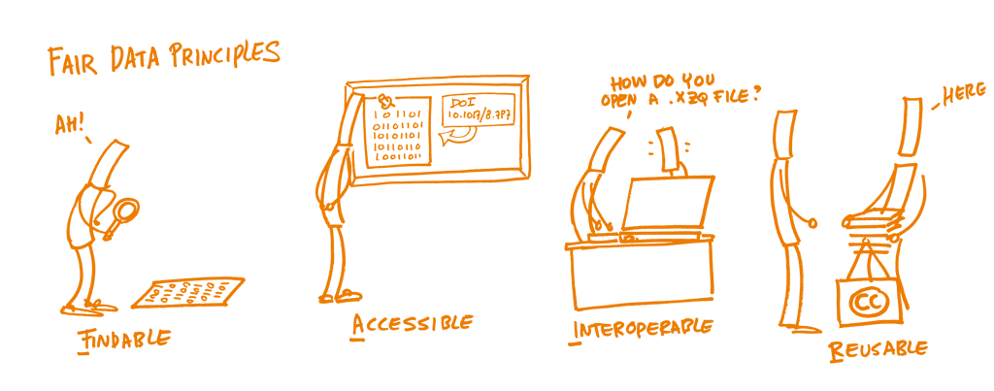
FAIR principles
Source: Assessing the FAIRness of data
https://www.fosteropenscience.eu/learning/assessing-the-fairness-of-data/#/id/5c52e8cf0d3def29462d8cb5
CC0 license

Slide 3
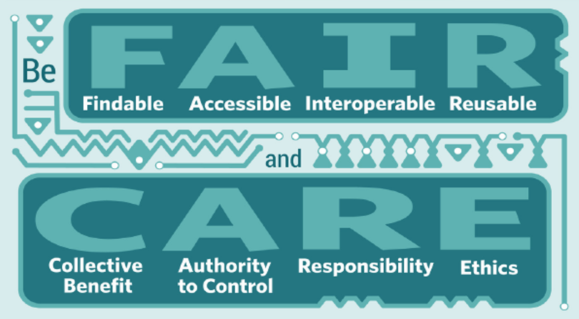
FAIR principles demystified
Data quality is not equal FAIR – but still one wish to optimise quality to make data more useful
Open data is not equal FAIR – as open as possible, as closed as necessary
Reusable is not equal to Reproducible – it helps to achieve the later, by enhancing transparency of the analysis that results in a scientific publication
There are other principles that complements the FAIR
Digital preservation principles – FAIR is all about reusability enhancement, that digital preservation principles add to – e.g. file formats for long-term preservation
Ethical principles: The European Code of Conduct for Research Integrity, chapter Data Practices and Management (mention FAIR among others)
CARE principles – „‘CARE Principles for Indigenous Data Governance’ address concerns related to the people and purpose of data“
Research Data Alliance International Indigenous Data Sovereignty Interest Group. CARE principles for Indigenous data governance. (The Global Indigenous Data Alliance, GIDA-global.org, September 2019).

Slide 4
Sound scientific practice in data creation and processing already cover much of the FAIR requirements
Research data management is a crucial skill for researchers. The availability of new data sources and technologies means that researchers deal with more data, and more complex data, than ever before. These developments affect the management of “big data” as well as qualitative data (e.g., text, audio, video, and images). At the same time, funders, journals, and communities of social science researchers have also begun to expect more transparent research practices, such as sharing the data and materials (questionnaires, statistical analysis code, etc.), underpinning research findings.
Trust Transparency
Diana Kapiszewski and Sebastian Karcher (2020): Managing Qualitative Social Science Data: QDR and SSRC Release Online Course. Accessible on https://items.ssrc.org/from-our-programs/managing-qualitative-social-science-data-qdr-and-ssrc-release-online-course/
„The next generation of researchers must learn not only modern research methods, they must learn modern methods of data management if they are to exploit their data assets effectively over the course of their careers.“
Christine L. Borgman (2016) Not Fade Away: Social Science Research in the Digital Era. Accessible on https://items.ssrc.org/parameters/not-fade-away-social-science-research-in-the-digital-era/

Slide 5
FAIR principles apply to both data and metadata
An illustration of granular indicators regarding FAIR data (a selection out of 41 indicators) – see the RDA FAIR Data Maturity Model WG.
Most needed are community specific implementation criteria (i.e. social sciences research community) – refereeing to established good practice
Research Data Alliance FAIR Data Maturity Model Working Group. ‘FAIR Data Maturity Model: Specification and Guidelines’, 2020. https://doi.org/10.15497/RDA00050.
FAIR | ID | Indicator | Priority
F1 | RDA-F1-01D | Data is identified by a persistent identifier | ⬤⬤⬤ | Essential
F1 | RDA-F1-02D | Data is identified by a globally unique identifier | ⬤⬤⬤ | Essential
A1 | RDA-A1-02D | Data can be accessed manually (i.e. with human intervention) | ⬤⬤⬤ | Essential
A1 | RDA-A1-03D | Data identifier resolves to a digital object | ⬤⬤⬤ | Essential
A1 | RDA-A1-04D | Data is accessible through standardised protocol | ⬤⬤⬤ | Essential
A1 | RDA-A1-05D | Data can be accessed automatically (i.e. by a computer program) | ⬤⬤ | Important
A1.1 | RDA-A1.1-01D | Data is accessible through a free access protocol | ⬤⬤ | Important
A1.2 | RDA-A1.2-01D | Data is accessible through an access protocol that supports authentication and authorisation | ⬤ | Useful
I1 | RDA-I1-01D | Data uses knowledge representation expressed in standardised format | ⬤⬤ | Important
I1 | RDA-I1-02D | Data uses machine-understandable knowledge representation | ⬤⬤ | Important
I2 | RDA-I2-01D | Data uses FAIR-compliant vocabularies | ⬤ | Useful
I3 | RDA-I3-01D | Data includes references to other data | ⬤ | Useful
I3 | RDA-I3-02D | Data includes qualified references to other data | ⬤ | Useful
R1.3 | RDA-R1.3-01D | Data complies with a community standard ⬤⬤⬤ |  | Essential
R1.3 | RDA-R1.3-02D | Data is expressed in compliance with a machine-understandable community standard ⬤⬤ |  | Important
E.g. linking to previous or related research data that provides additional context to the data.
Notes:
One does not need to know the FAIR principles details to be able to follow most of them by following good research principles…

Slide 6
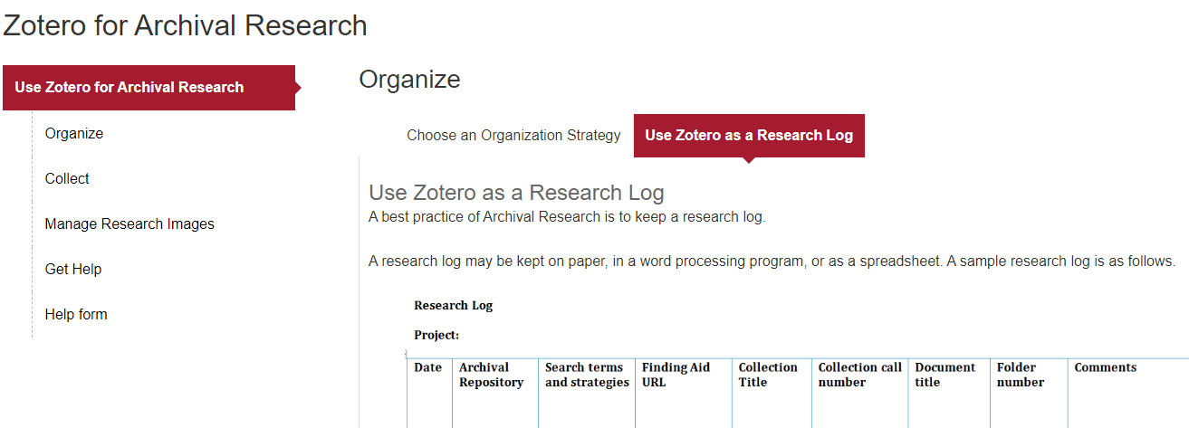
File and directory names conventions
Here is a sample naming convention: [LastNameorOrgName]_[CallNo]_[FolderNo]_[ImageNo]
Example 1: Julia Child Papers Child_MC660_1.1_001 Example 2: NOW Records NOW_MC666_2.1_001
Example tool for organising (qualitative) data files:
Source: https://guides.library.harvard.edu/zotero_archival_research

Slide 7
Advantages of systematic file naming
Bulk conversion: old_project_name_data_file1_v1.sav
Example:
Rename old_project_name*.* ID_project*.* → for large number of files this can save time
Enhance reproducibility: the transformations and analysis syntax code and the data files are systematically arranges so as to preserve consistency when moved to another location
Use relative paths!!!
REPRODUCIBILITY
Reproducibility is obtaining consistent results using the same input data, computational steps, methods, and code, and conditions of analysis. This definition is synonymous with “computational reproducibility.”
https://curating4reproducibility.org & https://osf.io/3wkex/

Slide 8
Files and Folder Structure: Example of a Research Compendia
Executable Compendium
compendium/
├── CITATION
├── code
│ ├── analyse_data.R
│ └── clean_data.R
├── data_clean
│ └── data_clean.csv
├── data_raw
│ ├── datapackage.json
│ └── data_raw.csv
├── Dockerfile
├── figures
│ └── flow_chart.jpeg
├── LICENSE
├── Makefile
├── paper.Rmd
└── README.md
Basic Compendium
compendium/
├── data
│ ├── my_data.csv
├── analysis
│ └── my_script.R
├── DESCRIPTION
└── README.md
The Turing Way Community, Becky Arnold, Louise Bowler, Sarah Gibson, Patricia Herterich, Rosie Higman, … Kirstie Whitaker. (2019, March 25). The Turing Way: A Handbook for Reproducible Data Science (Version v0.0.4). Zenodo. http://doi.org/10.5281/zenodo.3233986
Chapter Research Compendia accessible on https://the-turing-way.netlify.app/reproducible-research/compendia.html

Slide 9
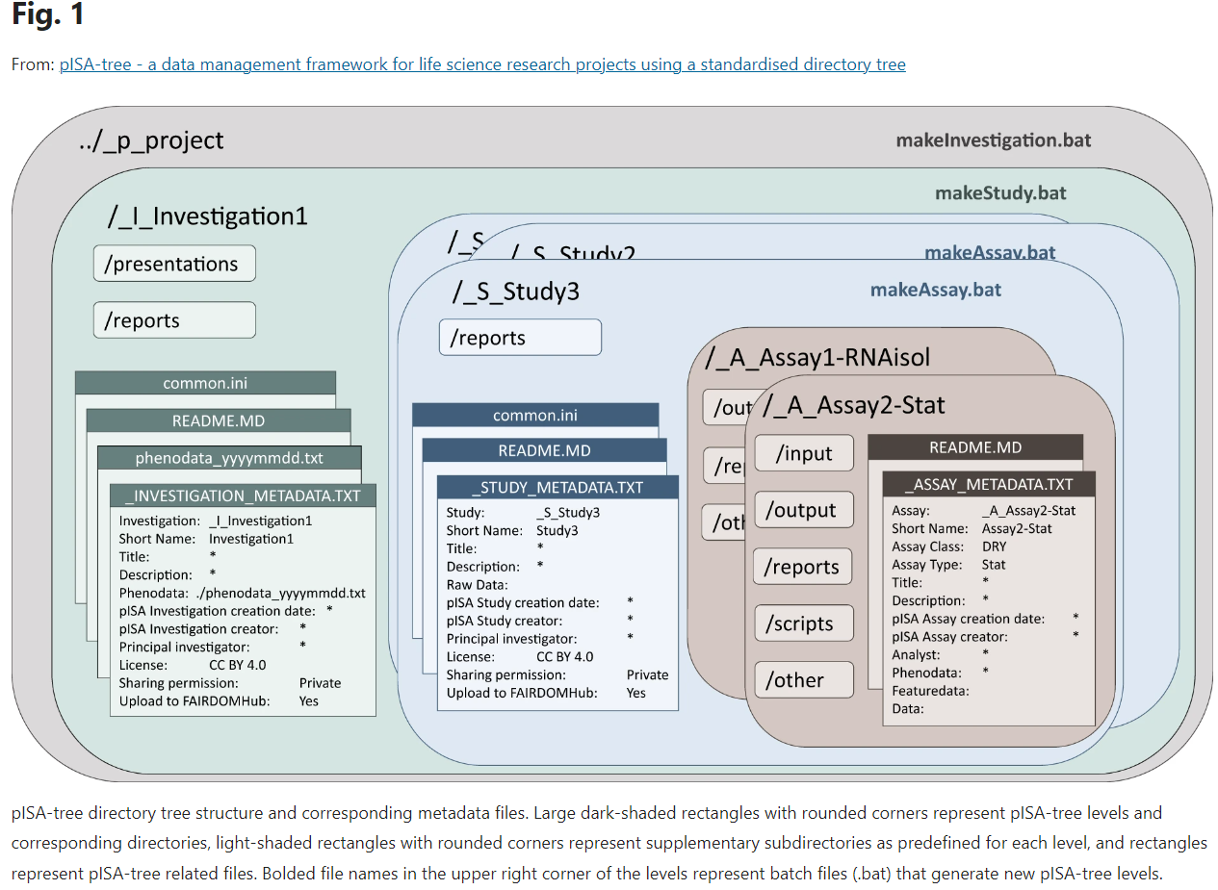
Example of an advanced approach: pISA-tree
Petek, M., Zagorščak, M., Blejec, A. et al. pISA-tree - a data management framework for life science research projects using a standardised directory tree. Sci Data 9, 685 (2022). https://doi.org/10.1038/s41597-022-01805-5

Slide 10
File formats and tools for qualitative data analysis
Research Transparency and Qualitative Data
Qualitative Data Analysis Software and Transparency
https://managing-qualitative-data.org/modules/4/b/
From Diana Kapiszewski and Sebastian Karcher (2020): Managing Qualitative Social Science Data: QDR and SSRC Release Online Course.
challenges of sharing CAQDAS-produced data is that every software product has its own, typically proprietary, export format
problematic for sharing and archiving
Solutions for file sharing:
First export to software’s dedicated export format (e.g., .nvp for NVivo, “Export Data” for Dedoose, or “copy bundle” for atlas.ti).
Then, create a second “human-readable” export all relevant files in widely used formats (such as RTF, PDF, Excel, as well as widely used video, image, and audio formats).
Also export all relevant memos as RTF or PDF files.
Or
Apply the REFI-QDA Project

Slide 11
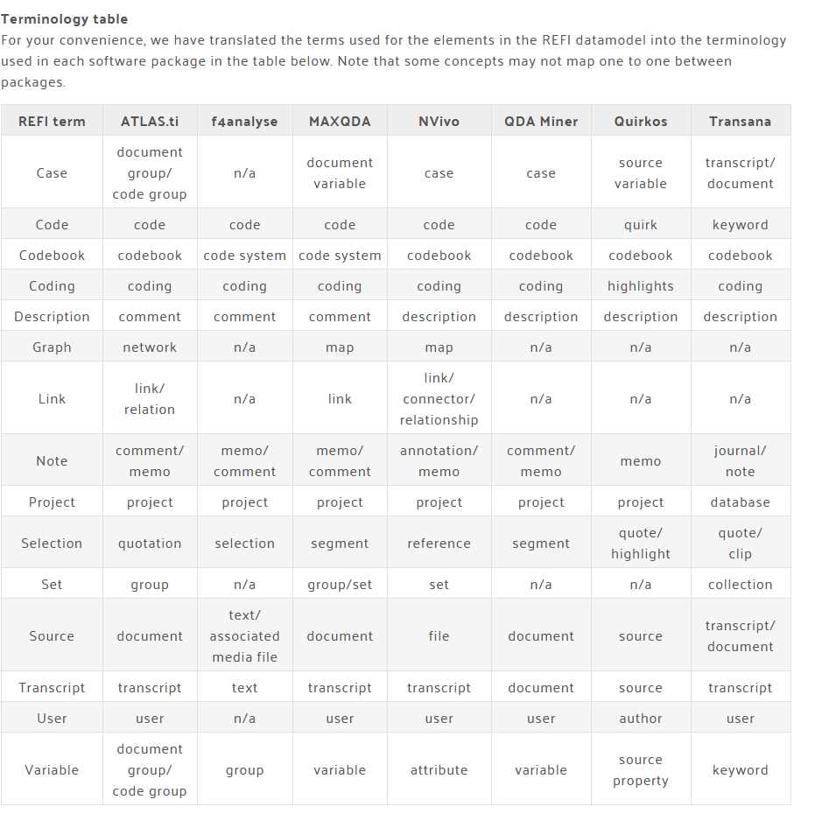
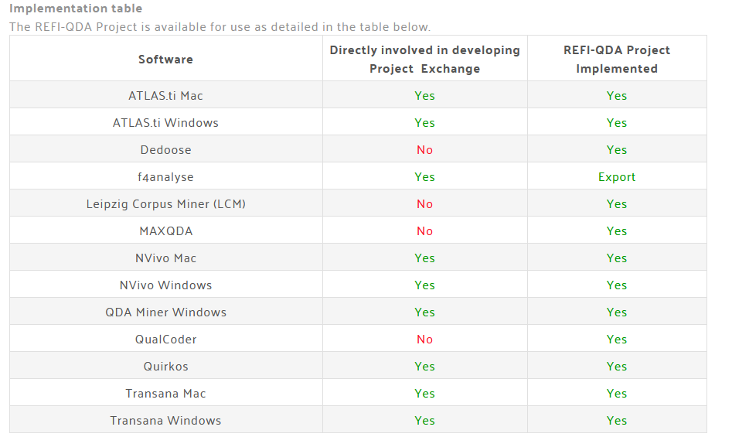
REFI-QDA Standard https://www.qdasoftware.org/products-project-exchange/
The REFI-QDA Standard enables interoperability between Qualitative Data Analysis Software (QDAS or CAQDAS) programs. Its purpose is to enable users to exchange processed data between programs.
Usefulness: a common standard maximizes the possibility of using project data in the future and for archiving purposes

Slide 12
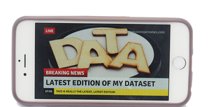
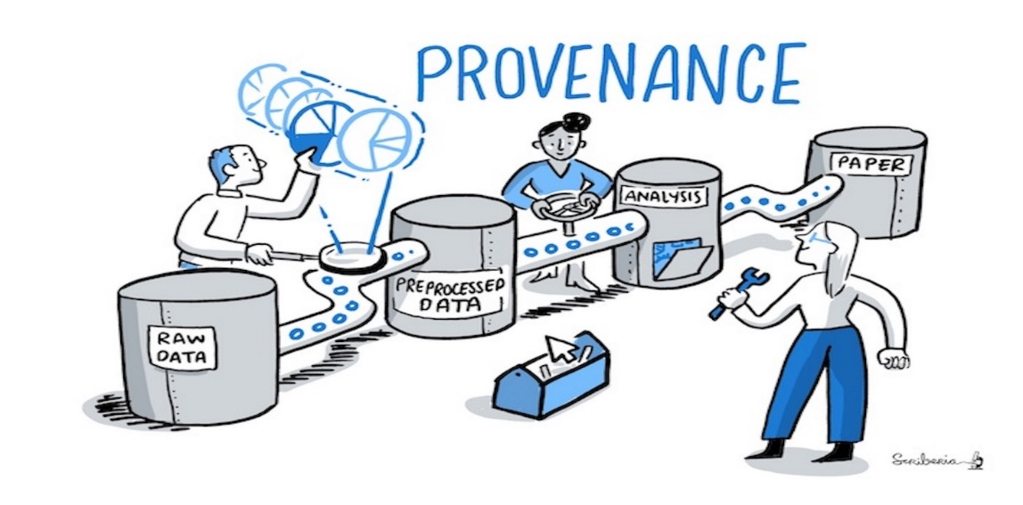
Versioning
https://dmeg.cessda.eu/Data-Management-Expert-Guide/3.-Process/Data-authenticity
Problem:
Often we find discrepancies between published summary statistical results and what is checked at the data archive…
Solution:
Versioning - To identify the exact version of a dataset as it was used in a specific project or publication, the Research Data Aliance (RDA) suggests that every dataset is versioned, timestamped, and assigned a persistent identifier (PID).
Advance solution
Some of the established repositories offer integration with GitHub, so that every version of data sets in those repositories can be recorded through it.
Dataverse Uploader
This action automatically uploads GitHub repository content to a Dataverse dataset. It can upload the entire repository or its subdirectory into an existing dataset on a target Dataverse installation. The action is customizable, allowing you to fully replace a dataset, add to the dataset, publish it or leave it as a draft version on Dataverse.
The action provides some additional metadata to the dataset, such as the origin GitHub repository, and it preserves the directory tree structure.
The Turing Way project illustration by Scriberia. Used under a CC-BY 4.0 licence. DOI: 10.5281/zenodo.3332807.

Slide 13
How to ... check the integrity of your files
Frequently carry out integrity checks to ensure that the stored data has not been corrupted.
This can be done with so-called checksum tools.
These allow you to detect if a file was changed in any way, intentionally or unintentionally.
Such tools create a 'digital fingerprint' - a string of numbers - from the bit values (the ones and the zeros) of a file.
Monitoring whether the fingerprint of a given file changes allows you to detect if a file was changed in any way intentionally or unintentionally.
More on :
https://dmeg.cessda.eu/Data-Management-Expert-Guide/4.-Store/Storage

Slide 14
1. Exercise: Calculate checksum for arbitrary file on your computer
Steps:
Open the Text & File Checksum Calculator. You can use https://defuse.ca/checksums.htm#checksums
Use Browse button to select the particular file
Use Calculate checksums button to generate an digital fingerprint value
Store the value
Then make a minor change in a file and repeat the sequence steps 2. to 4.
What did you establish? Write the answer to the Chat.

Slide 15
Unit level data organisation: qualitative data
Example:
Interview head
Interview date: 08.02.2013 [=8 February 2013]
Interviewer: Matt Miller
Pseudonym of interviewee: Ian
Occupation of interviewee: Journalist
Age of interviewee: 32
Gender of interviewee: Male
I: First I would like to ask you about your choice of profession. How did it come about that you decided to become a teacher? Ian: Well, you know, when I was a kid we had this really great guy teaching history....
Usual elements of a interview head are
• Background information of the participants - Gender, age, occupation, education etc.
• Situational information (time, place, the presence of other persons)
(…)

Slide 16
Organisation of variables (quantitative file)
FAIR-ness is all about links and relationships among objects in a study

Slide 17
Identification variables
Examples:
Census files, LFS (Labour force survey) files: household and individual unit identifiers…
ID_GO Household identifier / Household serial number (SERIAL)
/ ID_STAN Dweling id
IPUMS-International database.
Person number (PERNUM)
Utility: Person records also have their own unique identifiers -- see PERNUM.)
Always good to check if duplicate case exist in a data file!
Definition
PERNUM numbers all persons within each household consecutively (starting with "1" for the first person record of each household). When combined with SAMPLE and SERIAL, PERNUM uniquely identifies each person in the IPUMS-International database.

Slide 18
Identification variables / quantitative files
Example of complex identifiers structure
Data from SHARE project : A complicated database of micro data on health, socio-economic status and social and family networks
Panel survey:
same respondents interviewed every two years: id of respondent necessary to keep variables from consecutive waves
Different components of the survey with different sources of information collected under different data collection modes.
The data collection modes include face-to-face interviews based on computer-assisted personal interviewing (CAPI) on household level, CAPI on individual level for different types of household members, paper and pencil (PAPI) drop-off questionnaires
For each unit and variable in a data file it is good to know, which mode was used to collect information
Source:
https://dmeg.cessda.eu/Data-Management-Expert-Guide/2.-Organise-Document/Designing-a-data-file-structure

Slide 19
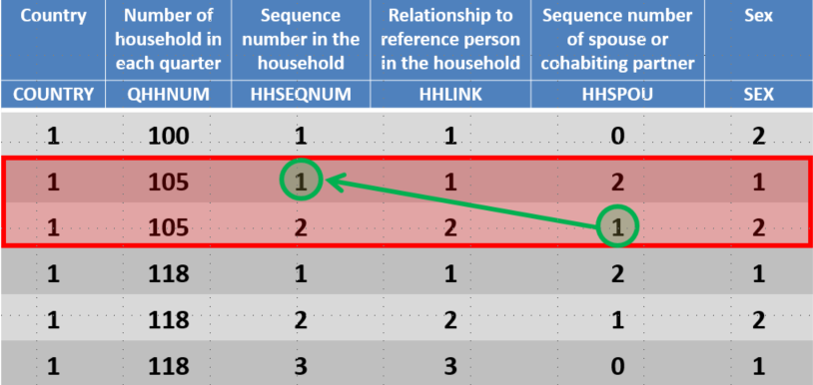
LFS exercise http://www.dwbproject.org/events/tc4.html
Fourth DwB Training Course
Working with data from official statistics in Europe – particularly the European Union Labour Force Survey (EU-LFS)
http://www.dwbproject.org/events/tc4.html
Calculate the prevalence of the different employment patterns of couples, depending on the age of the youngest child in the household (by country)
How to solve it
Combine the information of the employment status of both partners in one row of the dataset
Solution:
SELECT IF sex=2 AND hhspou>0.
SAVE OUTFILE='mydata_path/part_w.sav'
/ KEEP=country qhhnum hhspou age ilostat ftpt hatlev1d
/ RENAME (hhspou age ilostat ftpt hatlev1d=hhseqnum age_w ilostat_w ftpt_w hatlev1d_w).
MATCH FILES / FILE=*
/ TABLES='mydata_path/part_w.sav'
/ BY country qhhnum hhseqnum.

Slide 20
Assortative Mating analysis exercise
Interesting source for concepts and operationalisations: The Study of Assortative Mating: Theory, Data, and Analysis. Daniel T. Lichter and Zhenchao Qia In:Analytical Family Demography. (Editors) Robert Schoen https://doi.org/10.1007/978-3-319-93227-9
2. Exercise: Identify couples with the same or different education, … or other characteristics. And establish the degree of homogamy.
Use ‚id_go‘ – the household identifier, select for family type married or cohabitating
This is a thought exercise. Let just someone raise hand and speak!
Data for this exercise:
Statistical Office of the Republic of Slovenia. (2015). Register Census 2011: Public Use Microdata (5-percent sample) [Data file]. Ljubljana: University of Ljubljana, Slovenian Social Science Data Archives. ADP - IDNo: POPIS11P. https://doi.org/10.17898/ADP_POPIS11P_V1

Slide 21
Assortative Mating analysis exercise
Interesting source for concepts and operationalisations: The Study of Assortative Mating: Theory, Data, and Analysis Daniel T. Lichter and Zhenchao Qia v Analytical Family Demography
EditorsRobert Schoen https://doi.org/10.1007/978-3-319-93227-9
Exercise Identify couples with the same or different education, … or other characteristics. And establish the degree of homogamy.
*design partial male gender file, after selecting for family type married or cohabitating..
DATASET COPY male.
DATASET ACTIVATE male.
* sp = ‚Gender‘; 1 ‚male‘ 2 ‚female‘.
SELECT IF sp=1.
*again on original file, design partial female gender file
SELECT IF sp=2.
Join female and male file based on ‚id_go‘ – the hosehold identifier , rename the izob ‚education‘ variable for male.
MATCH FILES /FILE=*
/table='moski'
/RENAME (izb = izb_m)
/BY id_go
.
Data for this exercise:
Statistical Office of the Republic of Slovenia. (2015). Register Census 2011: Public Use Microdata (5-percent sample) [Data file]. Ljubljana: University of Ljubljana, Slovenian Social Science Data Archives. ADP - IDNo: POPIS11P. https://doi.org/10.17898/ADP_POPIS11P_V1

Slide 22
Data-level documentation: Conventions
Variable naming variants (good if length does not exceeds to much, no spaces and non-latin characters…):
Order in a file: V1, v2, … , Vnmax; in that case the relation to a question number is advisable in variable label: „Q11: How important is exercise for you?“
Same as question number
Mnemonic short names: (example from General social survey, a continuous survey https://gss.norc.org/documents/codebook/gss_codebook.pdf )
SPKCOM ‚ALLOW COMMUNIST TO SPEAK‘ * comment: different waves of survey will have the same
Prefix, root, suffix systems:
MAPRES10 ‚MOTHERS OCCUPATIONAL PRESTIGE SCORE (2010)‘
MAPRES105PLUS ‚MOTHERS OCCUPATIONAL PRESTIGE SCORE USING THRESHOLD METHOD (2010)‘
_____________________________________________________________________

Slide 23
Data-level documentation: quantitative data
CESSDA Training Team (2017 - 2022). CESSDA Data Management Expert Guide. Bergen, Norway: CESSDA ERIC. Retrieved from https://dmeg.cessda.eu/
https://dmeg.cessda.eu/Data-Management-Expert-Guide/3.-Process/Quantitative-coding
Advices:
Variable-level documentation should ideally stay in a data file.
This includes the names, labels and descriptions of variables, their values, a description of derived variables, missing values…
Example: SPSS *.sav or Stata *.dta data file, containing data records and variable labels, value labels, variable formats and missing data information.
Link to original wording of the survey question should be available
In a structured DDI Codebook, machine active links can be annotated, that contains links to the related information, such as questions and variables, information on full question text, the definitions of concepts etc.

Slide 24
Tools to use for editing and expanding variable-level documentation
Colectica (Colectica® is the fastest way to design, document, and publish your statistical data and survey research using open data standards. From https://www.colectica.com/)
Dataverse-Data-Curation-Tool
stand-alone component is built to complement The Dataverse Project ( ? Ask your university DataVerse installation maintainer to add it to a suit)
„The Data Curation Tool (DCT) allows data owners and curators to view summary statistics for variables and to create and edit variable-level metadata for any tabular file in a data set. This stand-alone component is built to complement The Dataverse Project.“
Others:
QAMyData (https://ukdataservice.ac.uk/about/research-and-development/past-projects/qamydata/ )
(https://openrefine.org/ )
See https://githb.com/scholarsportal/Dataverse-Data-Curation-Tool

Slide 25
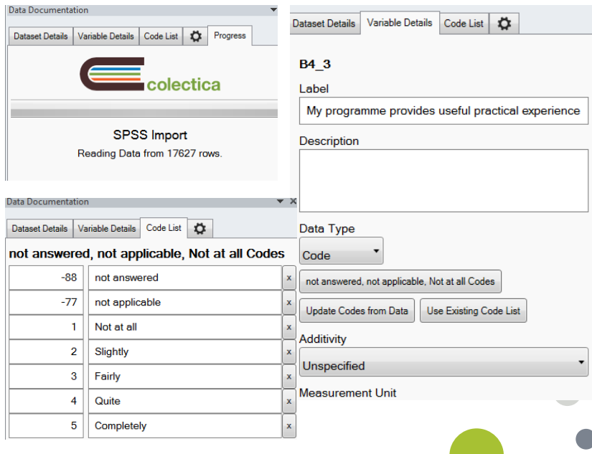
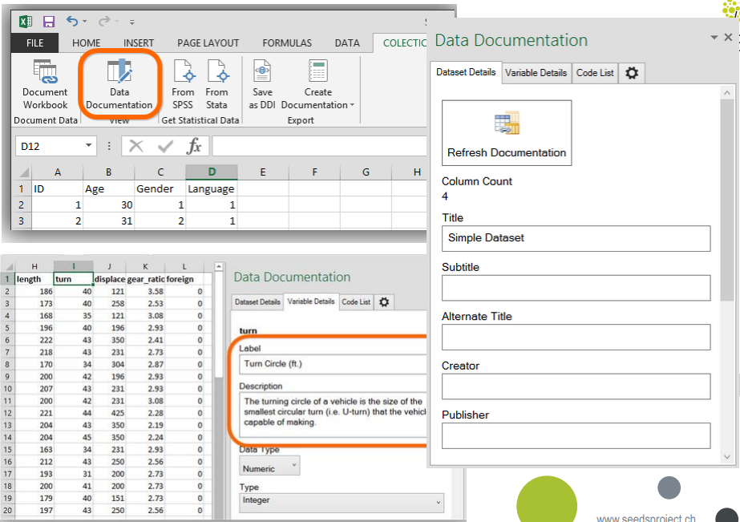
Inside Colectica

Slide 26
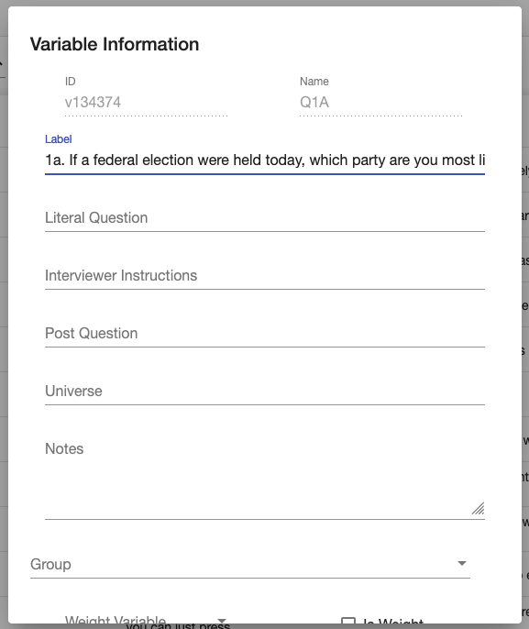
Inside The Data Curation Tool (DCT)
View
summary statistics about a variable, specifically its values, categories, count, count percentage, and weighted count. A bar chart of the variable is also presented.
Edit
By uploading a file, pre-existing information associated with variables is saved (value and variable labels)
Other fields are "Literal Question", "Interviewer Instructions", "Post Question", "Universe", "Notes", "Group", and the option to mark a variable as a "Weight Variable".
Groups
Groups allow you to collect variables together to form a subset of variables in the dataset.

Slide 27
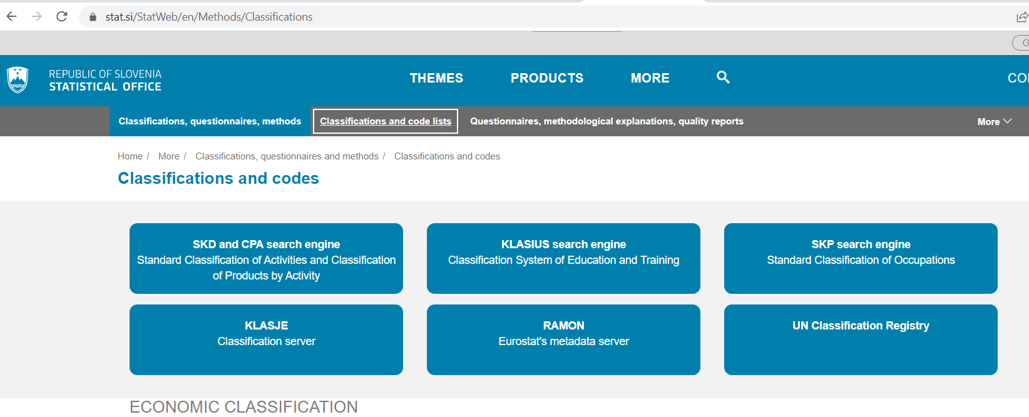
Example: Establish a relation from variable in a file to the external classification server
Classifications server of Statistical Office

Slide 28
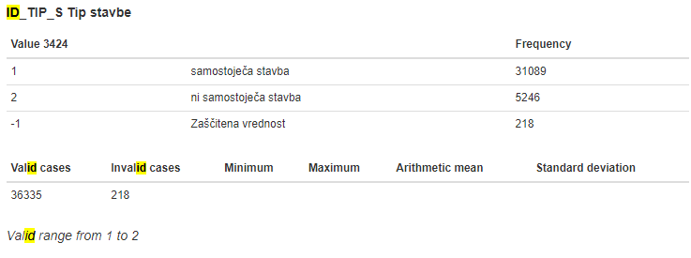
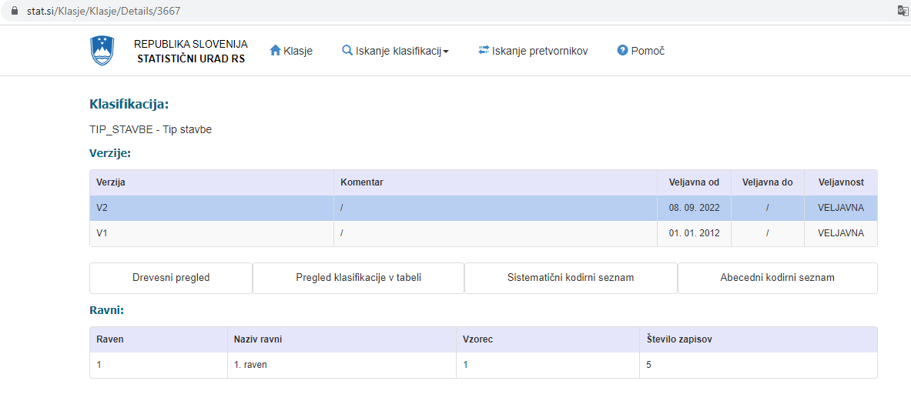
Simple Human Readable data relations
Data file source: Statistical Office of the Republic of Slovenia. (2015). Register Census 2011: Public Use Microdata (5-percent sample) [Data file]. Ljubljana: University of Ljubljana, Slovenian Social Science Data Archives. ADP - IDNo: POPIS11P. https://doi.org/10.17898/ADP_POPIS11P_V1
Popis (Census) file variable naming
The identifier of a variable in a data file and a codebook that is accessible from the public data archive is linked to the „Statistical classifications registry“, kept at the national statistical office.

Slide 29
Data level documentation - Advice:
CESSDA Training Team (2017 - 2022). CESSDA Data Management Expert Guide. Bergen, Norway: CESSDA ERIC. Retrieved from https://dmeg.cessda.eu/
https://dmeg.cessda.eu/Data-Management-Expert-Guide/3.-Process/Quantitative-coding
Preserve original information
„Recording original data, such as age and income, is more useful than collapsing or bracketing the information. With original or detailed data, secondary analysts can determine other meaningful brackets on their own rather than being restricted to those chosen by others.“
Example: Age variable
How would be ideally measured and documented in a survey?
Derived from month and year when born.
Date of conducting inteview (I_Date_M, I_Date_Y).
Variable label Age_Y_M : „Respondent: Age in Years and Month [F 4,2], derived from R_Year, R_Month and I_Date_M, I_Date_Y: COMPUTE Age_Y_M = (I_Date_Y + (I_Date_M *100000)) - (R_Year + (R_Month *100000))“
To extend the example: compute the Completed Age in Years
Variable label R_Age: „Respondent: Age in Years Completed [F 2,0] derived from COMPUTE R_Age = trunc(Age_Y_M).“
3. Exercise: Which other derived variable would you imagine in your secondary analysis project?
Again, this is a thought exercise, so you are encouraged to speak aloud!

Slide 30
Missing values annotation conventions
Advice:
establish a uniform system for coding missing values for the entire database. Typically, negative values or values like 7, 8, 9 or 97, 98, 99 or 997, 998, 999, etc. → Ut.: based on this you can execute commands on a whole range of variables.
Blanks should be avoided if ambiguous (e.g. it is not clear if the question was inadvertently skipped, or if it is a refusal).
Survey research standard categories (frequently used acronyms are bracketed):
No answer (NA): The respondent did not answer a question when he/she should have;
Refusal: The respondent explicitly refused to answer;
Don’t Know (DK): The respondent did not answer a question because he/she had no opinion or did not know the information required for answering. As a result, the respondent chose ‘don’t know’, ‘no opinion’ etc. as the answer;
Not Applicable/Inapplicable (NAP/INAP): A question did not apply to the respondent. (question was skipped following a filter question)
See Guide to Social Science Data Preparation and Archiving. Best Practice Throughout the Data Life Cycle: 6th Edition. Accessed on https://www.icpsr.umich.edu/web/pages/deposit/guide/index.html

Slide 31
Examples of useful commands in data processing
(SPSS)
RENAME VARIABLES M20=M20_1.
AUTORECODE VARIABLES=varlist
/INTO new varlist
MISSING VALUES V1 (8,9) V2 V3 (0) V4 ('X') V5 TO V9 (' ').
Keywords for numeric value lists:
LO, LOWEST, HI, HIGHEST, THRU
RENAME VARIABLES (JOBCAT=TITLE).
RECODE V1 TO V3 (0=1) (1=0) (2,3=-1) (9=9) (ELSE=SYSMIS).
Input keywords:
LO, LOWEST, HI, HIGHEST, THRU, MISSING, SYSMIS, ELSE
Output keywords:
COPY, SYSMIS
RECODE STRNGVAR ('A','B','C'='A')('D','E','F'='B')(ELSE=' ').
Input keywords:
CONVERT, ELSE
Output keyword:
COPY
More in: SYTAX FOR MANAGING DATA FILES
Version 1.3; prepared for SEEDS Workshop in Ljubljana
https://www.adp.fdv.uni-lj.si/seeds_workshop2_lj2016/presentations/SPSS%20and%20Stata%20commands%20v3.docx

Slide 32
Keep the syntax that produced the file version
Each transformation to the variables in a file should be documented.
The syntax (code) file with comments is necessary to keep track.
The original and derived file should both be available, if someone would like to check or alter the transformation → Remember file naming convention for versions of the files
The advanced approach:
The code of variable transformation can be written in a Structured Data Transformation Language (SDTL) that is designed to preserve the executability of the code for long-term preservation
SDTL provides a new level of transparency for data processed and managed by statistical analysis packages. SDTL was created to simplify the automated creation of provenance metadata at the variable level.
Conversion from one to another syntax: The C2Metadata Project is providing open-source code for translating SPSS, SAS, Stata, R, and Python into SDTL, as well as code for translating SDTL into natural language
Alter, G., Donakowski, D., Gager, J., Heus, P., Hunter, C., Ionescu, S., Iverson, J., Jagadish, H., Lagoze, C., Lyle, J., Mueller, A., Revheim, S., Richardson, M. A., Ørnulf, R., Seelam, K., Smith, D., Smith, T., Song, J., Vaidya, Y. J., & Voldsater, O. (2020). Provenance metadata for statistical data: An introduction to Structured Data Transformation Language (SDTL). IASSIST Quarterly, 44(4). https://doi.org/10.29173/iq983

Slide 33
Use of standard demographics variables
Utility:
Provide base for operationalisation of the social science concepts!!! Derived variables based on standard classifications codlings, e.g. ESsEC…
Harmonised variables enable joining data across space and time
Comparability (https://ec.europa.eu/eurostat/web/quality/quality-monitoring/quality-reporting )
Comparing sample distribution and reliable official distribution for quality assessment
AND it enhance Interoperability (Remember FAIR?)

Slide 34
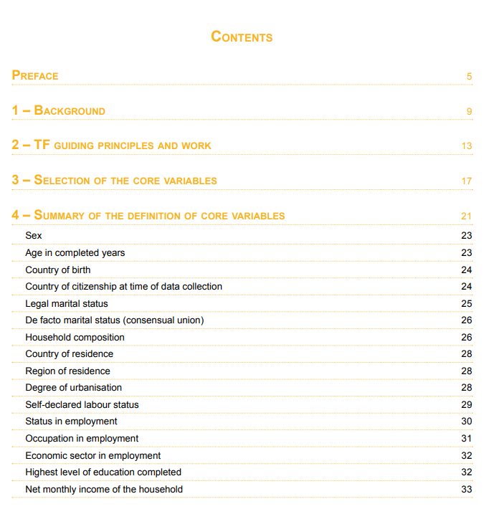
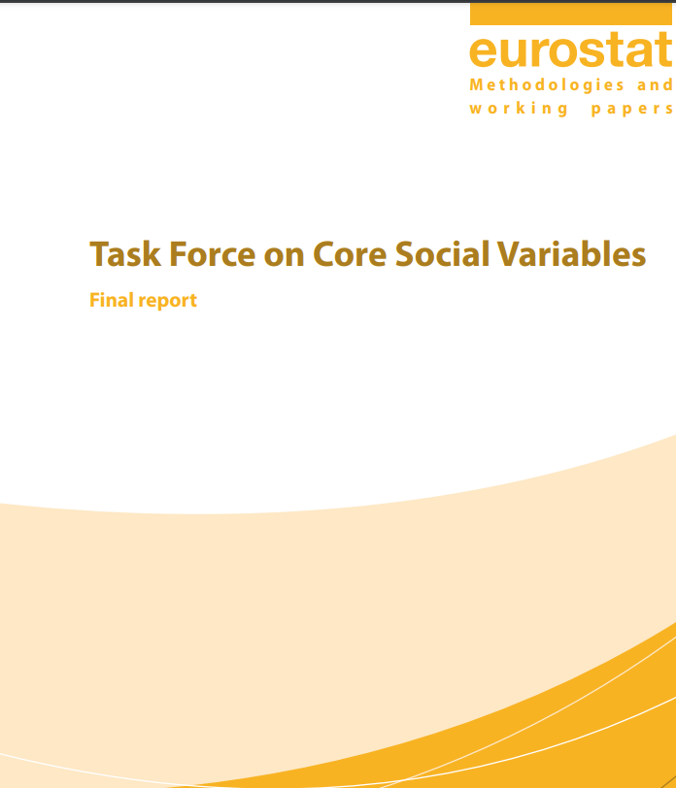
"Core Social Variables„ initiative from Eurostat
Agreement about definitions and inclusions of the set of ‚core‘ variables in international data collections
(LFS, EU-SILC, …)
Objectives:
better identification of specified populations across all the surveys
to allow for socio-economic analysis based on the main structural variable
Output harmonisation of existing sources or registers
Use of international standards in the definition
Task Force on Core Social Variables - Final report. EC Eurostat. ISBN: 978-92-79-04714-5
https://ec.europa.eu/eurostat/documents/3859598/5901513/KS-RA-07-006-EN.PDF.pdf/71481ffb-771a-489b-a749-1a055c0247d4?t=1414781378000

Slide 35
Measuring and coding general social science classifications
What is surveycodings.org?
Surveycodings.org is a free service for survey projects, data archives and researchers measuring and coding socio-economic background variables and more general social science classifications.
It provides questionnaires, data collection tools, coding frames, and classifications based on standard statistical classifications for a large number of countries and languages (industry, occupation, educational attainment, field of education, religious denominations, social networks, cost of living, and region.)
Provided materials can be used to collect harmonised and cross-nationally comparable data as well as for post-hoc harmonisation of already collected data (e.g. coding of open-ended questions).
Foster the use of selected global ontologies in SSH: occupations, tasks, industry, geographical regions, food items, education, and religions
https://www.surveycodings.org/articles/home

Slide 36
Task example: Historical occupations coding
Digitalisation and harmonisation of archived tables from first half 20th century Primorska region in Slovenia (the region where border changed several times, and municipalities stayed under different jurisdiction.
Researcher asked for advice to fulfil FAIR criteria of a Grant agreement requirement:
Then, I write to you on metadata for interoperability and ISO codes for geographical units (Using GeoNames). Please, find in attachment the file with the list of economic sectors, jobs and localities.
Where can I find the metadata for them?
Resources to use:
HISCO classification with coding instructions
https://historyofwork.iisg.nl/
The GeoNames geographical database covers all countries
https://www.geonames.org/
Final resulting data files published at: Mezzoli, E. (2022). Historical data of the labour force, 1945-1947: Zone A-AMG-Venezia Giulia (Allied Military Government) [Data file]. Ljubljana: University of Ljubljana, Slovenian Social Science Data Archives. ADP - IDNo: HDS47. https://doi.org/10.17898/ADP_HDS47_V1
WeCanIt H2020-MSCA-IF-2019 - Grant agreement No. 894257

Slide 37
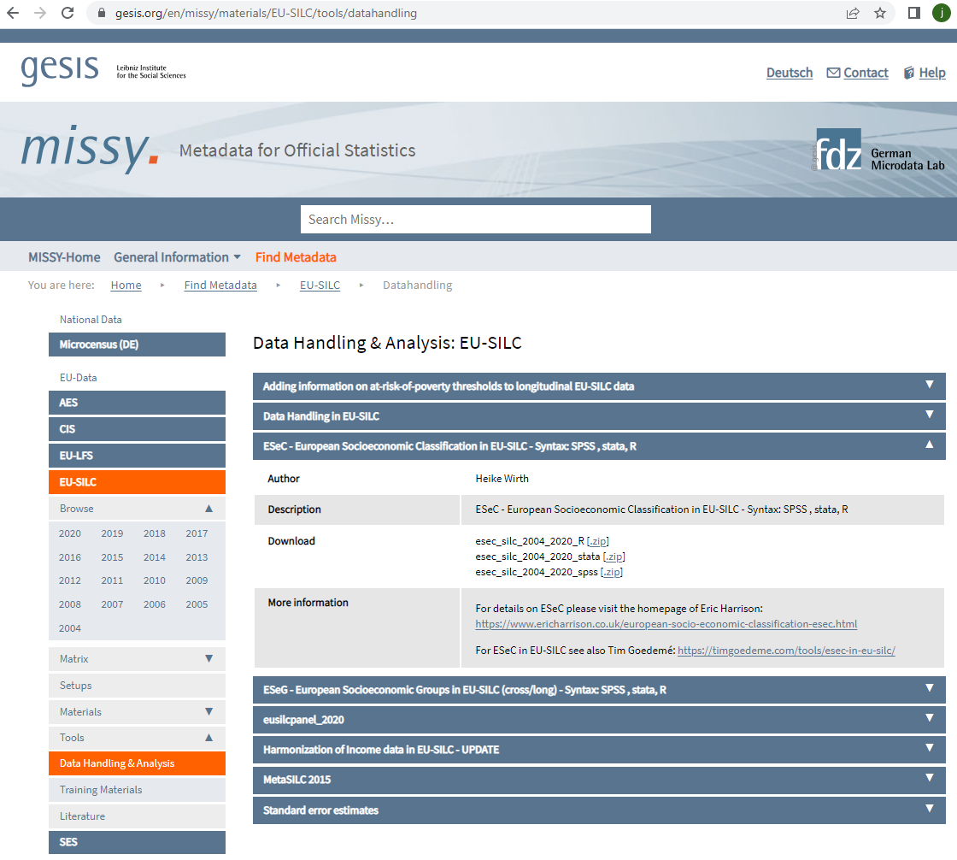
Dear colleagues,
in case you work with EU-SILC microdata you might be interested in the upate of our ESeC (European Socioeconomic Classification) tools (SPSS, Stata, R) . An update of ESeG (European Socioeconomic Groups) will follow soon.
You will find the syntax here: https://www.gesis.org/en/missy/materials/EU-SILC/tools/datahandling
http://www.gesis.org/unser-angebot/daten-analysieren/amtliche-mikrodaten/european-microdata/eu-silc/
click on: ESEC - European Socioeconomic Classification in EU-SILC - Syntax: SPSS , stata, R
For details on ESeC please visit the homepage of Eric Harrison
Example of a source of operationalisations of some established social science concepts!

Slide 38
Excerpts from the spss syntax file obtained
**blocks of syntax for each employment status variable***
*self-employed 10+.
.
do if (empstat=1).
recode ESEC08
(1, 10, 11, 12, 13, 14, 20, 21, 22, 23, 24, 25, 26, 30, 31, 32, 33, 34, 35, 40, 41, 42, …
91, 92, 93, 94, 95, 96 =1)
(2 ,3 ,54 =3)
(63 =5) .
end if.
execute.
*fre var=ESEC08 .
(…)
var labs ESEC08 'ESEC08'.
val labs ESEC08
1 'Large employers, higher mgrs/professionals'
2 'Lower mgrs/professionals, higher supervisory/technicians'
3 'Intermediate occupations'
4 'Small employers and self-employed (non-agriculture)'
5 'Small employers and self-employed (agriculture)'
6 'Lower supervisors and technicians'
7 'Lower sales and service'
8 'Lower technical'
9 'Routine'
-98 'Not selected respondent'
-97 'currently not working'
-99 'missing information'.
* check the new created variables .
recode empstat ESEC08 (sysmis=-99).
crosstabs ESEC08 by empstat /MISSING = INCLUDE .
(…)
* Wirth, Heike/ Gilsbach, Judith (2022): 2020_esec08_silc.sps.
* https://www.gesis.org/en/missy/materials/EU-SILC/tools/datahandling
* The following command should contain the complete path and the name of the SPSS data file (P-File) .
* change path to your file path.
* change spss_filename to to your spss filename (extension .sav).
file handle p_file / name='path\spss_filename'.
GET File = p_file. ************************************************************************************************
* Variables used
* PB020: Country (alphanumeric)
* PL051: ISCO08 (2-digit); PT: coarsend 11,12,13 = 14)
* PL040: Status in employment
* PL031: self-defined current economic status
* PL130; PL130_F: Number of Persons working at the local unit; Flag
* PL150: managerial position
* PX040: Respondent status

Slide 39
FAIR, but ethical? Two competing ideas when it comes to data archiving and anonymisation
Preservation Policies
“Preservation Policies should be in line with the core mission of the organization as well as the legal framework in order to ensure permanent accessibility to archives' holdings or secure access to specific datasets (sensitive data, data under embargo period, etc.).
(Sensitive) Personal Data
“Data producers can deposit both, ‘raw’ (primary data that is not transformed in any way) and/or anonymized data. In practice, data archives often receive and accept ‘raw’ data. If it includes personal data, archivists usually work closely with data producers to make a decision regarding anonymization, since only anonymized data (i.e. data that do not contain any information that may lead to the identification of a particular individual) can be shared/distributed to secondary users. If the data contain too much personal information and the deletion of all this information would severely limit the scientific value of the data, the data are usually left as they are and the access to them is restricted.
This does not apply if data sharing is stated differently in the consent form, e.g. when respondents approved sharing their personal data.”
Source: CESSDA Training Team (2022). CESSDA Data Archiving Guide version 1.0. Bergen, Norway: CESSDA ERIC.
Notes:
Provide practical examples that differentiate between legal and ethical considerations, allowing attendees to think what type of information must be shared with participant e.g. what will happen with the data when it’s used during the project, when it is preserved, when it is shared with others. Trainers must pay particular attention to this topic.

Slide 40
Key Concepts in Anonymisation
Types of identifiers: direct (names, address etc.) vs indirect (education level, occupation, age etc.)
De-identification/Pseudonymisation: Process of removing or masking direct identifiers in personal data
Anonymisation: Process of ensuring that the risk of somebody being identified in the data is negligible; more than simply de-identifying the data, and often requires that indirect identifiers be further altered or masked
Different types of anonymization methods exists
Notes:
Trainers should keep in mind that introducing key concepts differs from one type of audience to another. If for example the training is for early career researchers providing in depth definitions and multiple examples is a must. If however the session is for more experienced researchers a more brief overview of key concepts can be provided. However key concepts should be included in all sessions.

Slide 41
Treating indirect identifiers
Commonly used types of treatment are as follows:
Removal — Eliminating the variable from the dataset entirely.
Top-coding — Restricting the upper range of a variable.
Collapsing and/or combining variables — Combining values of a single variable or merging data recorded in two or more variables into a new summary variable.
Sampling — Rather than providing all of the original data, releasing a random sample of sufficient size to yield reasonable inferences.
Swapping — Matching unique cases on the indirect identifier, then exchanging the values of key variables between the cases.
Disturbing — Adding random variation or stochastic error to the variable. This retains the statistical properties between the variable and its covariates, while preventing someone from using the variable as a means for linking records.

Slide 42
Practical steps in Anonymization: qualidata
Anonymisation plan
• Decide if you need pseudonyms?
• What need to be removed and/or categorized?
• Is the exact occupation common or out of ordinary?
• What proper names and locations are revealing and which are not?
• What detailed information can be left in the data file?
For instance, if you categorize the participant’s age and the place of residence is categorized systematically, some details may be left intact
• Check what exactly is mentioned in the consent about the confidentiality and anonymity
• Decide whether you need to categorize the data unit level information
• Glance through the data file
• Are there proper personal names?
• Are there other proper names (organisations, firms)
• Are there unique locations (place names) mentioned?
Arja Kuula-Luumi, FSD: Curating qualitative data. SEEDS Workshop II Ljubljana, 9.-11. February, 2016. https://www.adp.fdv.uni-lj.si/seeds_workshop2_lj2016/presentations/SEEDS_WS2_KUULA_AIP_qualitative.pdf
Arja Kuula-Luumi, FSD: Hands- on: curating the RRPP qualitative data. SEEDS Workshop II Ljubljana, 9.-11. February, 2016. https://www.adp.fdv.uni-lj.si/seeds_workshop2_lj2016/presentations/SEEDS_WS2_KUULA_AIP_hands-on.pdf

Slide 43
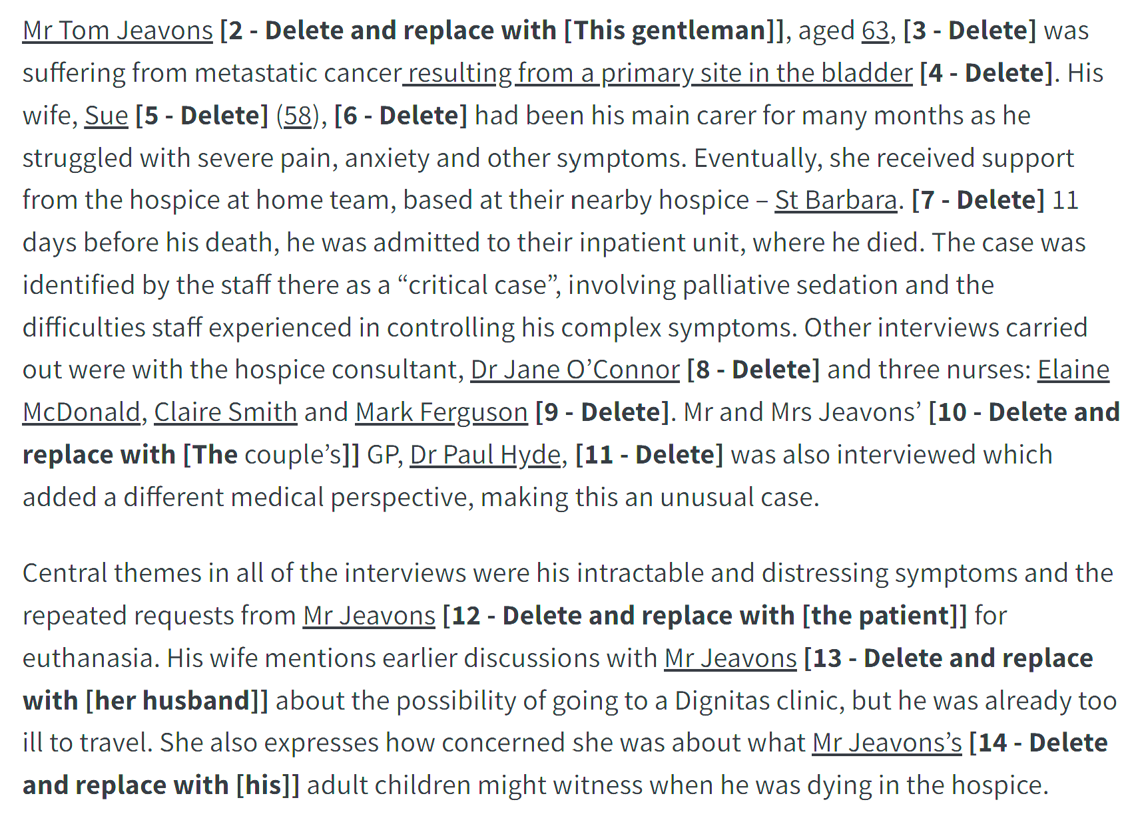
Qualitative Anonymisation Exercise Example
`
Source: DMEG Anonymisation
Notes:
Example of qualitative anonymisation exercise

Slide 44
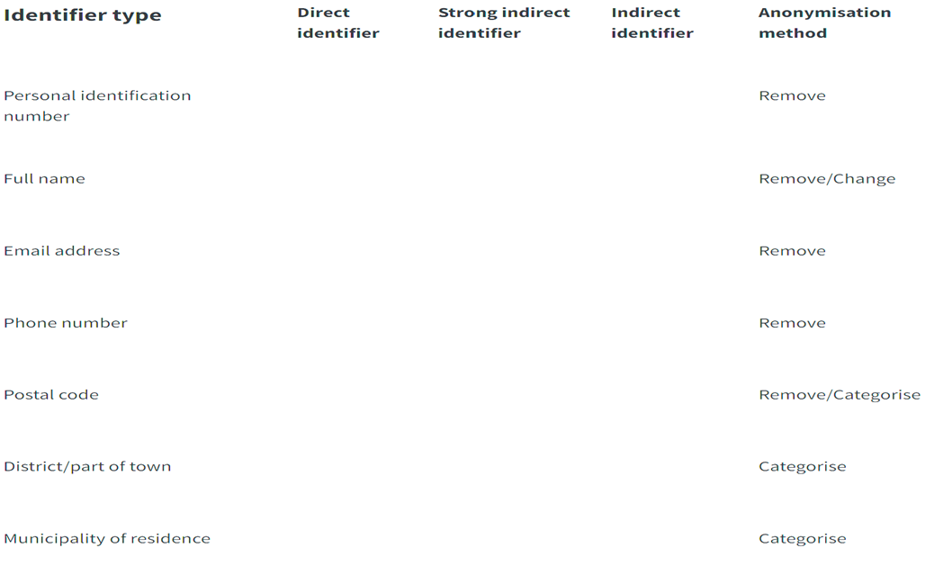
Quantitative Anonymization Exercise
4. Exercise: Assign Identifier type and Anonymization method

Slide 45
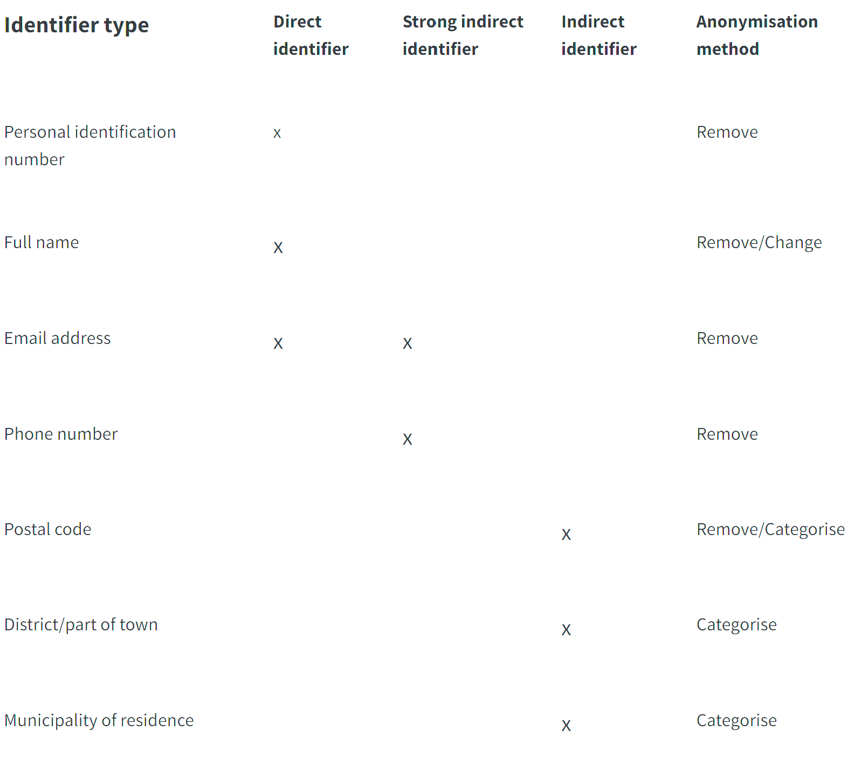
Exercise solution

Slide 46
Example of Anonymisation Freeware
sdcMicro – R scripting + GUI, reference manual; new Shiny GUI – in detailed vignette, SDC methods and sdcMicro; in depth guide for SDC and sdcMicro
QAMyData – provides functionality for identifying direct identifiers with the use of regular expressions (RegEx)
Amnesia anonymisation tool – standalone tool, locally run with comprehensive documentation
μ-Argus – standalone tool recommended by Eurostat for government statisticians; software and manual
ARX – comprehensive open source software for anonymizing sensitive personal data; software and documentation
Magder, Cristina, Prandner, Dimitri, Chylíková, Johana, Glavica, Marijana, and Watteler, Oliver. ‘How to Ensure Researchers Share Their FAIR Data: Practical Tips and Tool [Train-the-Trainer Workshop]’, 27 October 2022. https://doi.org/10.5281/ZENODO.7252952.
Notes:
Example of quantitative anonymisation freeware.

Slide 47
When and how about anonymization
I. an M. Schmutte and Lars Vilhuber. 2020. ‘“Balancing Privacy and Data Usability: An Overview of Disclosure Avoidance Methods.” In: Cole, Dhaliwal, Sautmann, and Vilhuber (Eds), Handbook on Using Administrative Data for Research and Evidence-Based Policy. Accessed at Https://Admindatahandbook.Mit.Edu/Book/v1.0-Rc3/Discavoid.Html on 2022-07-29.’, n.d.
When De-identification Is Not Necessary (qualidata)
Not all qualitative data garnered from human participants need to be de-identified.
Elites who are accustomed to journalistic interviews. Data that are already part of the public record (e.g., public statements by politicians) don’t need to be de-identified.
If consent obtained allow for identified data, shared in a repository
If the anonymization reduce the usability of data, or if not feasible at all:
You may share the data under restricted access conditions
“(y)ou will rarely be able to protect their identities from absolutely everyone. For instance, if you interview people in a small village, you can often mask their identities from other researchers and most everyone else, but their neighbor, knowing that you talked to them, would likely be able to recognize them from shared data. When complete de-identification is impossible, particularly when the data are very sensitive, controlling access to data can be a useful complement to (or replacement for) de-identification.” (https://managing-qualitative-data.org/modules/3/b/#de-identifying-data )

Slide 48
Thank you! Questions?
Janez.Stebe@FDV.Uni-Lj.Si

